Slide 1
Innovative Strategies for Developing and Funding Projects In a Volatile Policy Landscape

Slide 2
GridMarket Executive Summary
Solution
Target Market
A technology-agnostic AI-driven clean energy platform to help facilities identify, install, and optimize projects
Large energy consumer portfolios - manufacturing facilities, data centers, logistics/transportation, cold storage, etc.
Business Model
Success
No risk opportunity assessments with ongoing support paid through a success fee
Fortune 500 and 1000 customers contracted and in pipeline; globally operational projects with diverse technology mixes
Proprietary & Confidential – GridMarket 2025

Slide 3
2+
4+
2+
Trillion
Gigawatts
Billion
DATA POINTS PROCESSED THROUGH THE GRIDMARKET PLATFORM USING AI/ML
LISTED SOLAR PV, BATTERY STORAGE, EV, FUEL CELL, AND MICROGRID DEALS
PROPERTIES PREQUALIFIED FOR CLEAN ENERGY OPPORTUNITIES
Proprietary & Confidential – GridMarket 2025

Slide 4
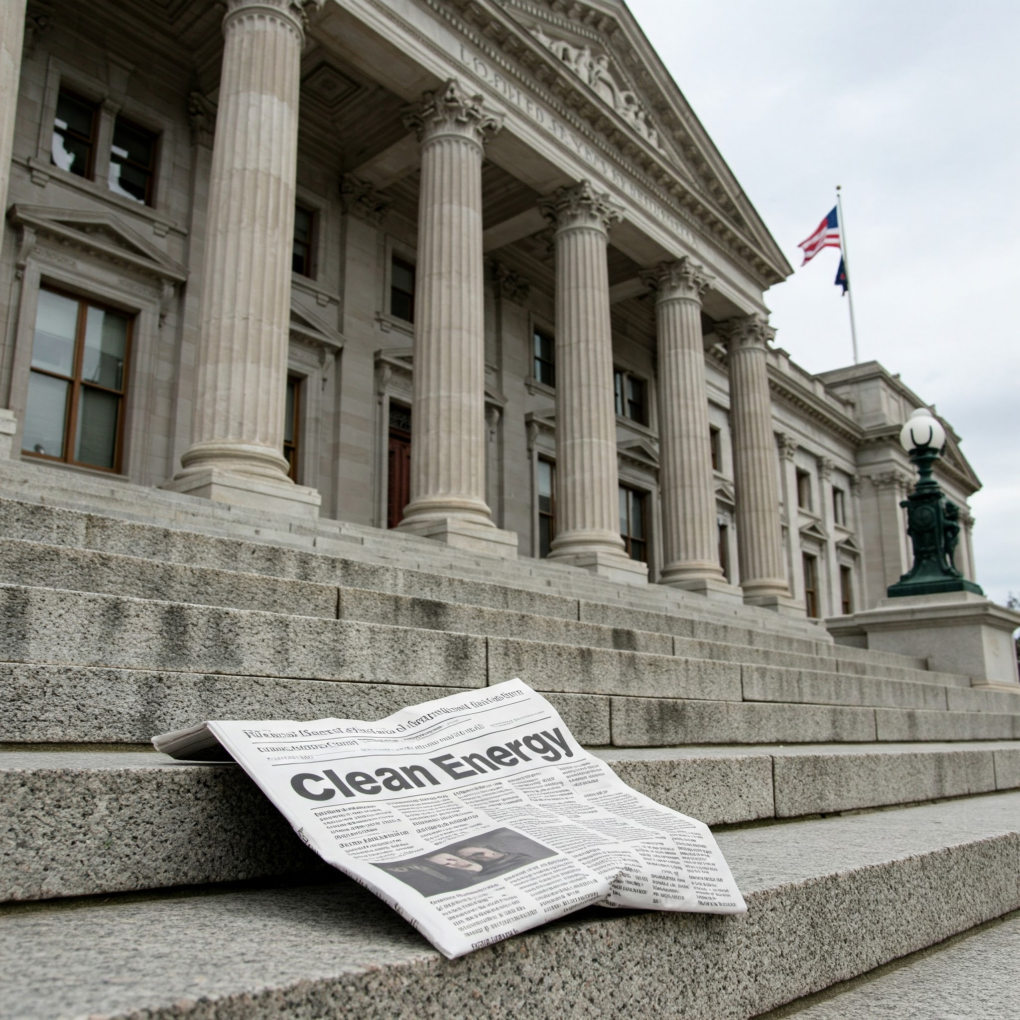
Turning Market Volatility Into Market Consistency
Proprietary & Confidential – GridMarket 2025

Slide 5
Microgrids and Multi-Asset Systems
Looking beyond single technologies or 100% renewable can make projects operate within customer need and align with financial goals
Politics prioritizes victory - does not have the needs of the customer in mind
There can be better approaches than only prioritizing tax credits based on goals, needs, and location
Looking across portfolios and considering all relevant technologies available in the market
Proprietary & Confidential – GridMarket 2025

Slide 6
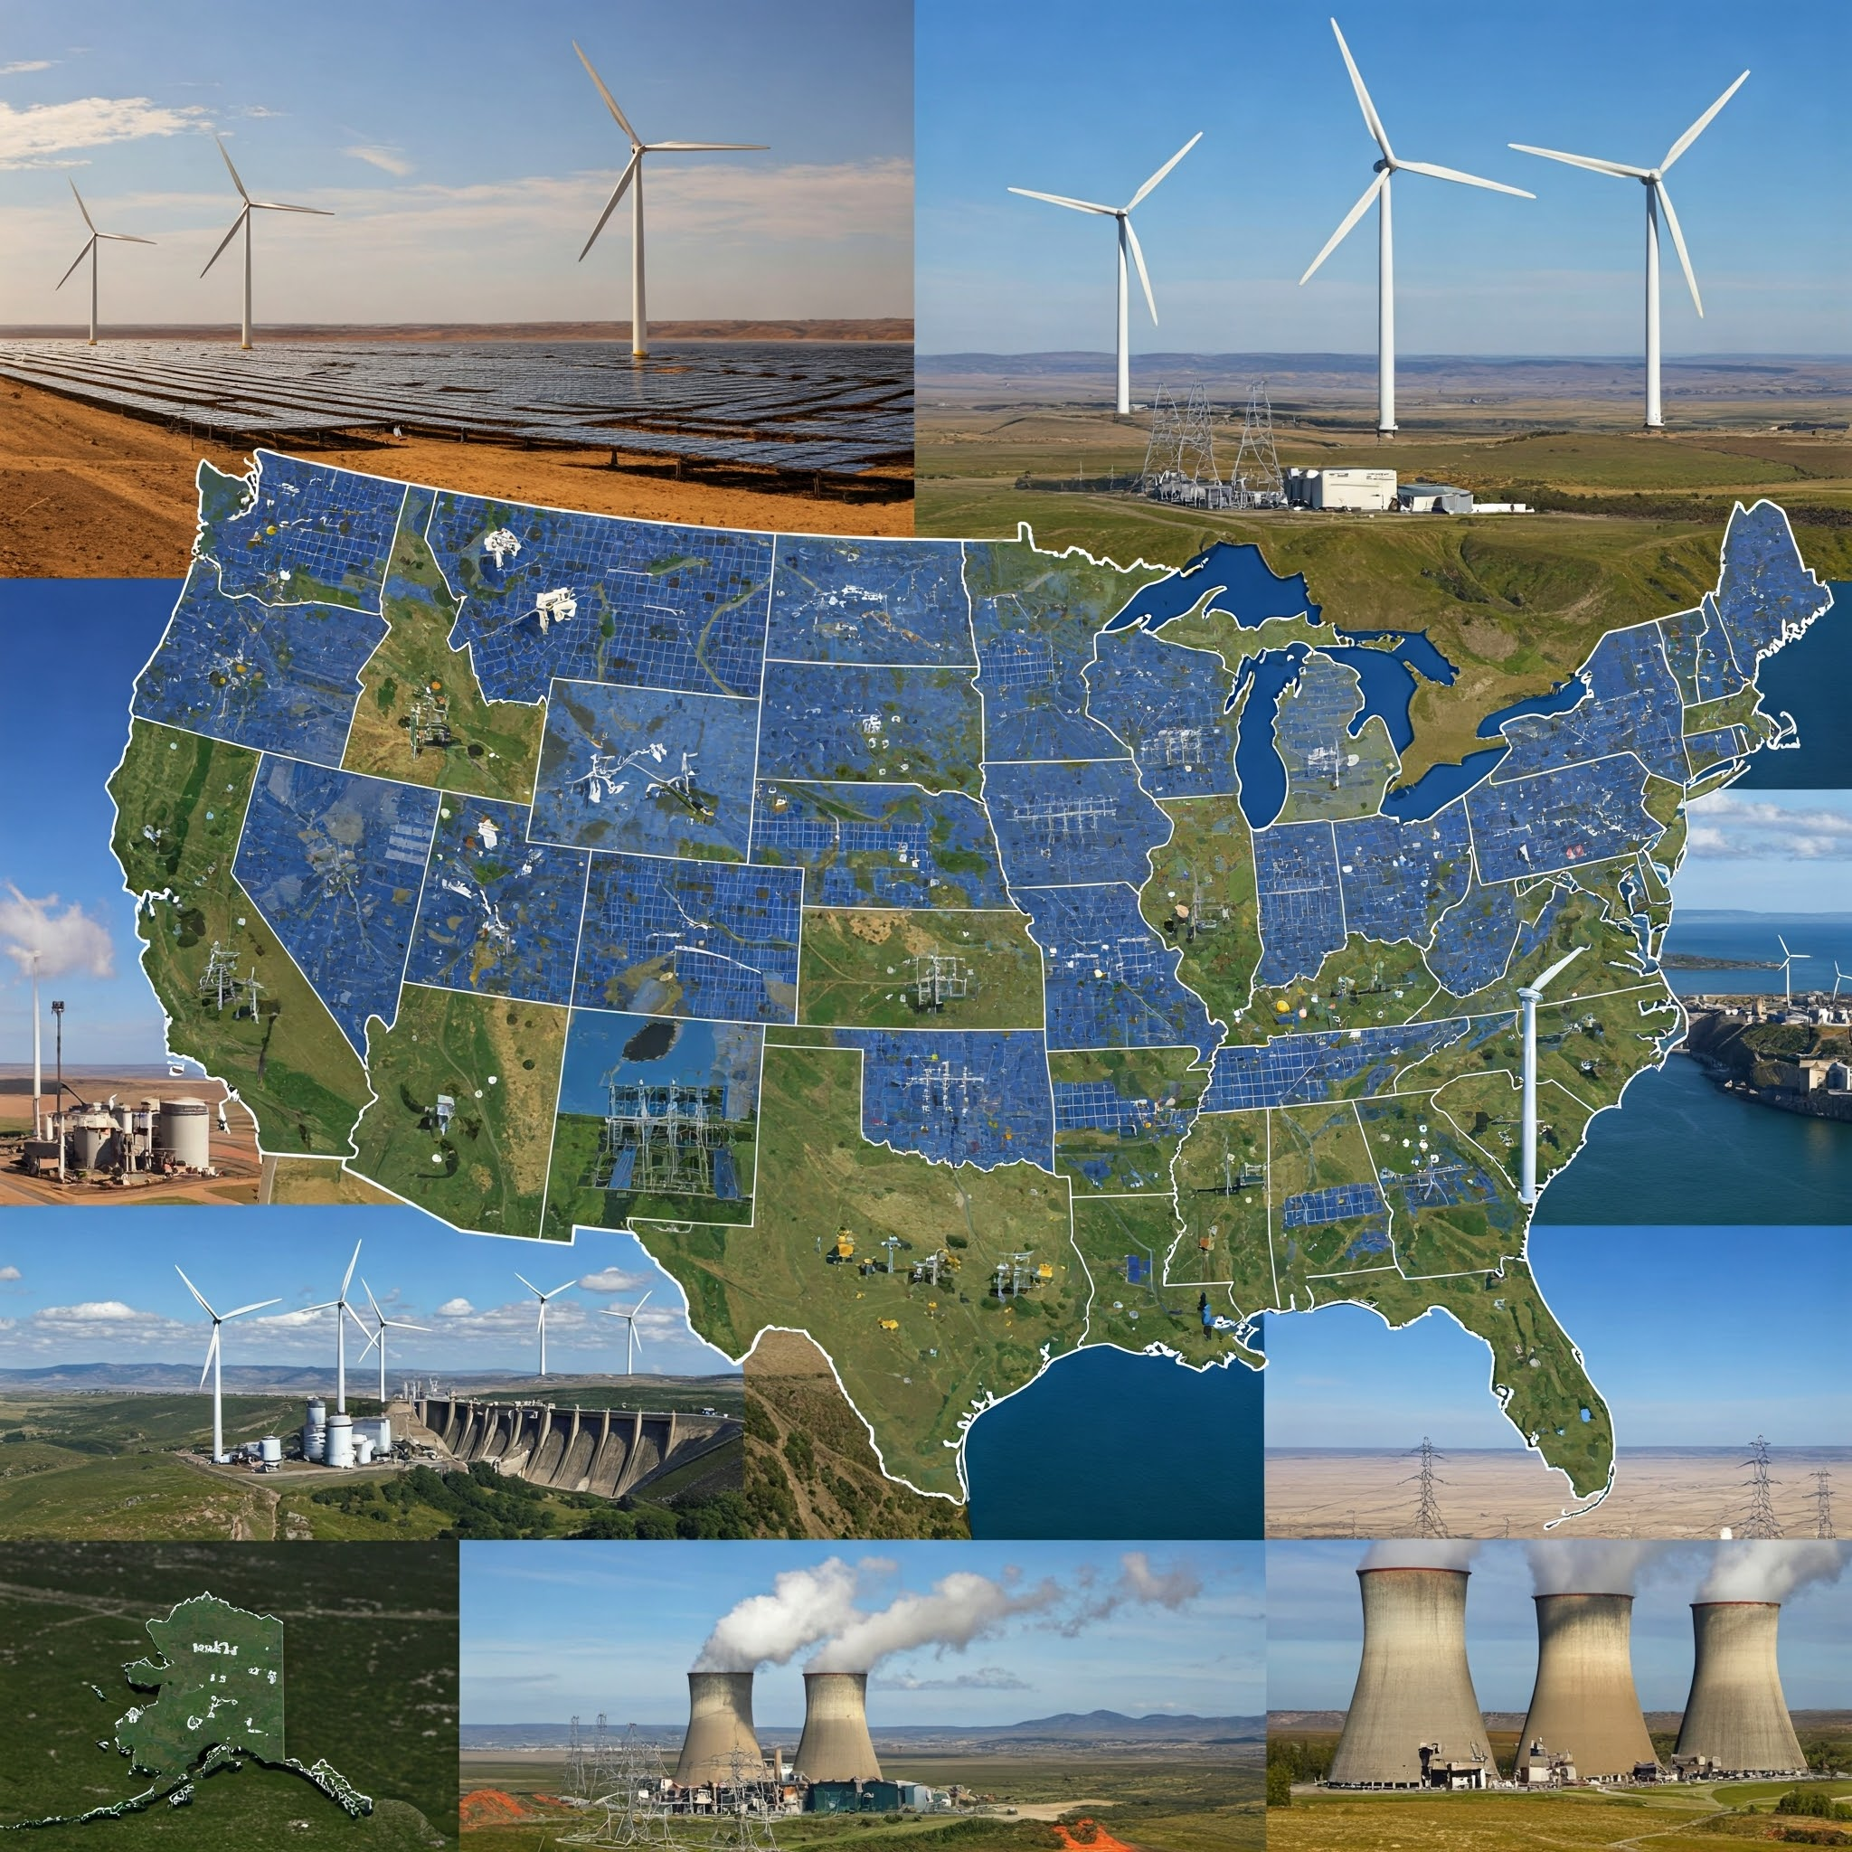
Customer Need > Politics
Proprietary & Confidential – GridMarket 2025

Slide 7
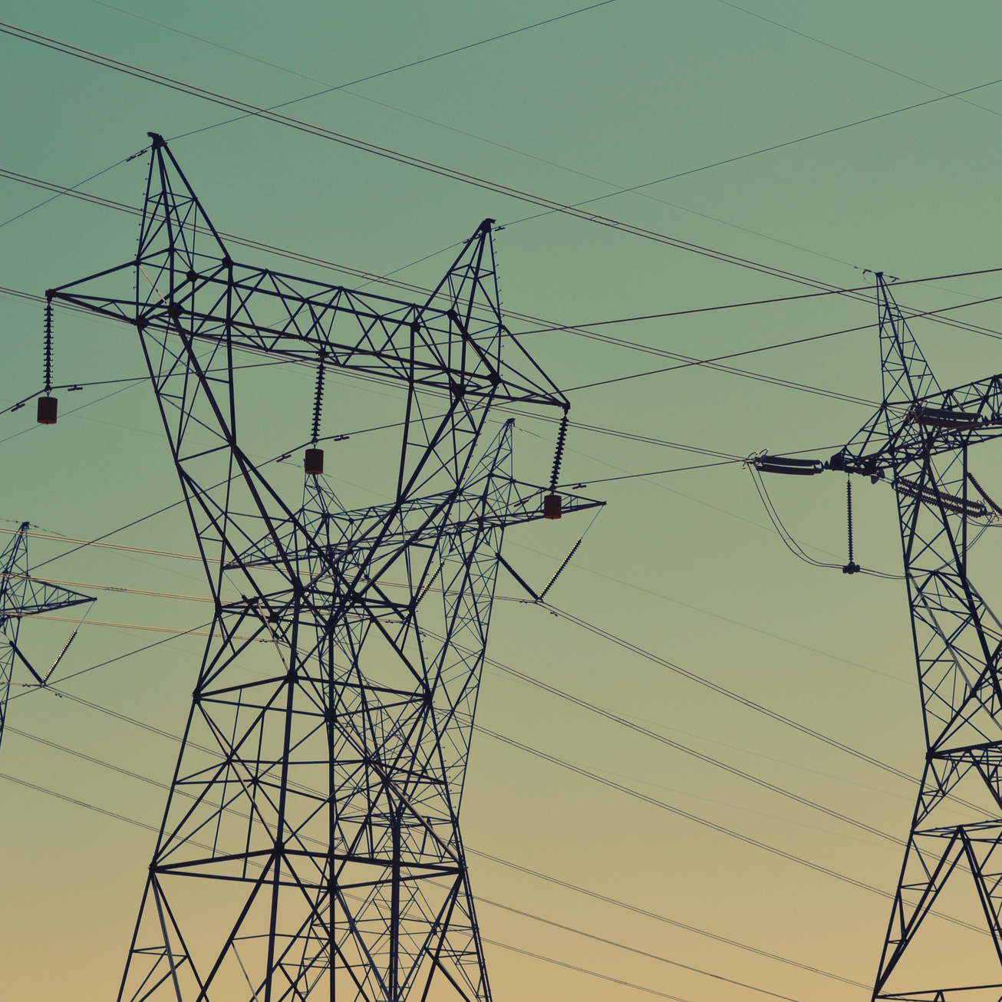
Follow the needs of the customer, not just the policy landscape
Success requires innovation, flexibility, and a willingness to embrace change in order to make projects happen
Energy Security
Resiliency and Reliability
Sustainability & Carbon Targets
Price Stability
On-Site Generation
Proprietary & Confidential – GridMarket 2025

Slide 8
Different property types - the same general needs and solutions
Looking to grow at scale
Leverage digital tools and AI
Meet demand needs on site
Work within need, not within policy
Proprietary & Confidential – GridMarket 2025

Slide 9
Soft Cost Reduction
AI and automation can improve traditional development processes, reduce resources necessary from all stakeholders, and optimize projects from design to operation
Example of cost impact using a digital tool like GridMarket
Proprietary & Confidential – GridMarket 2025

Slide 10
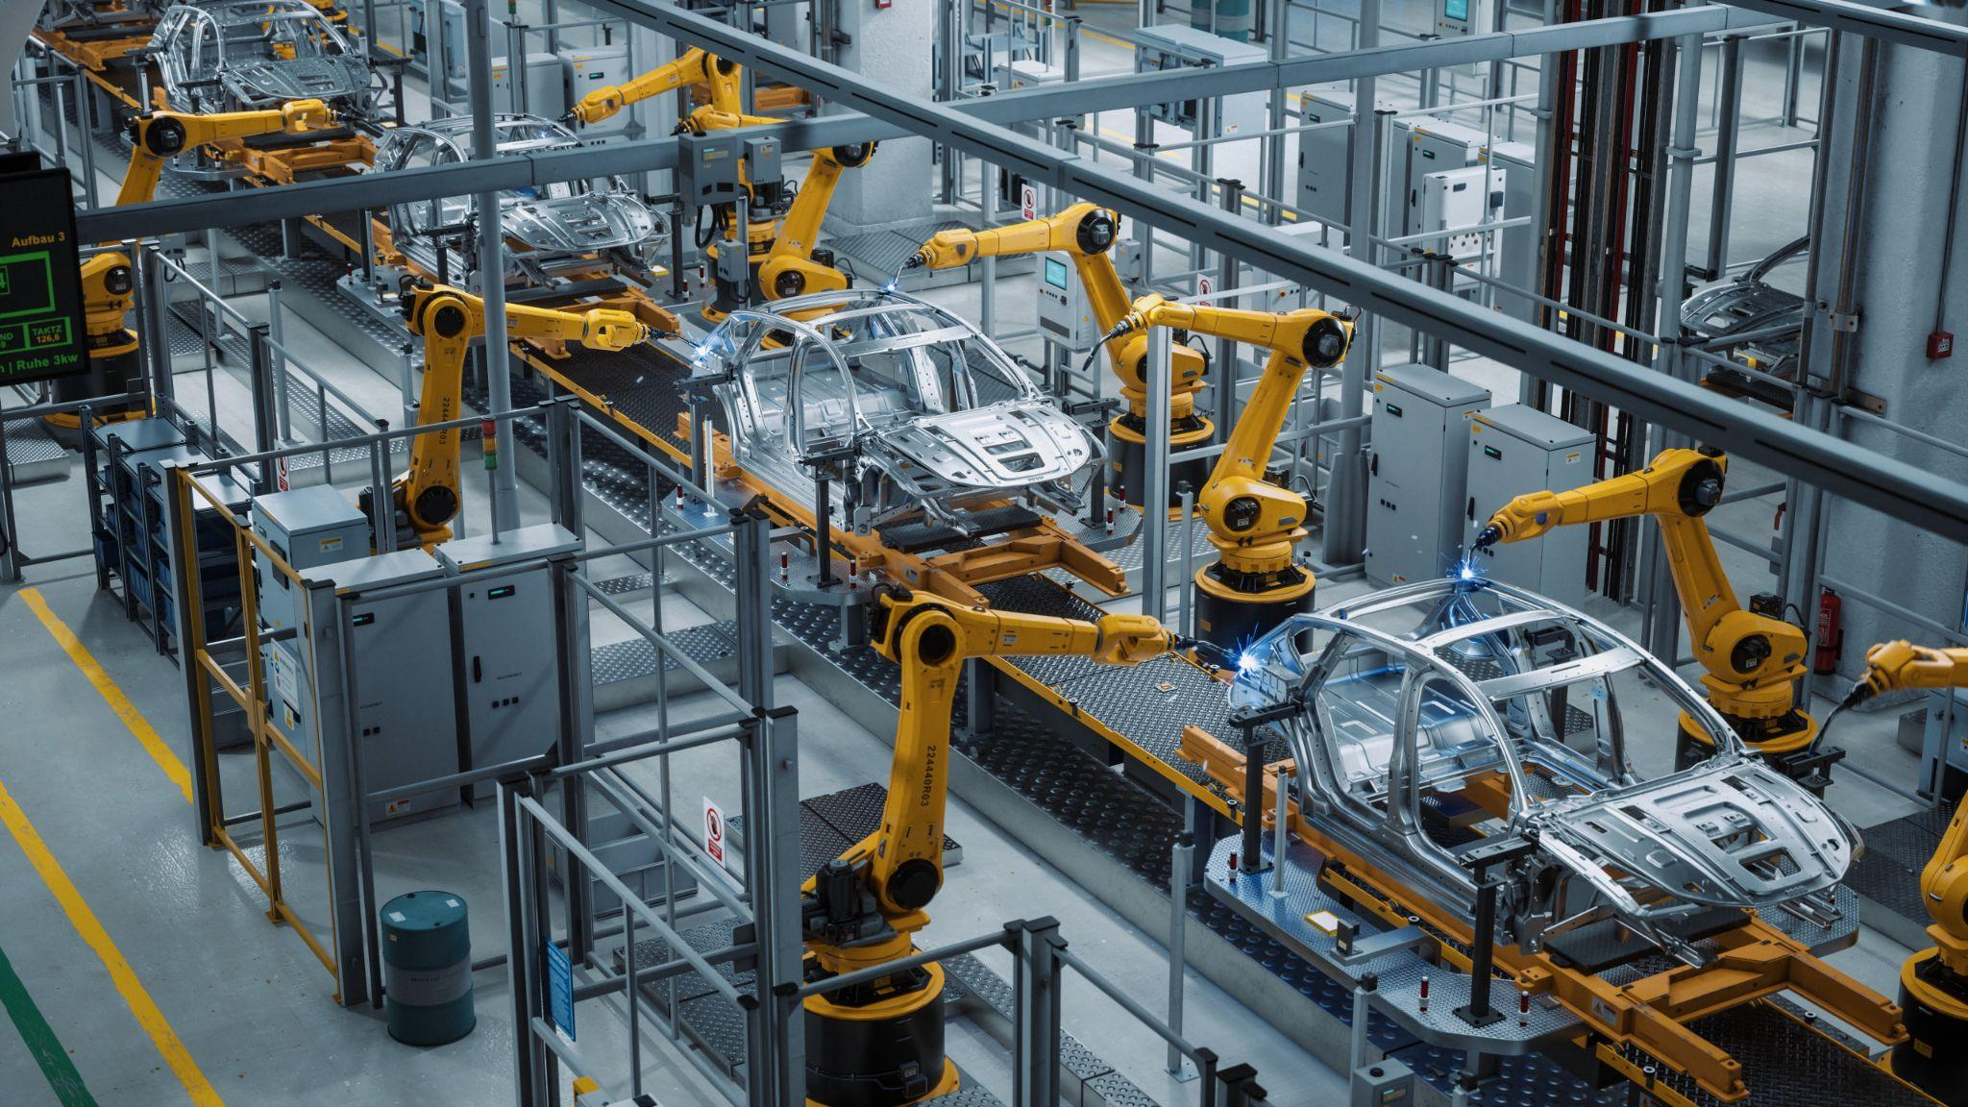
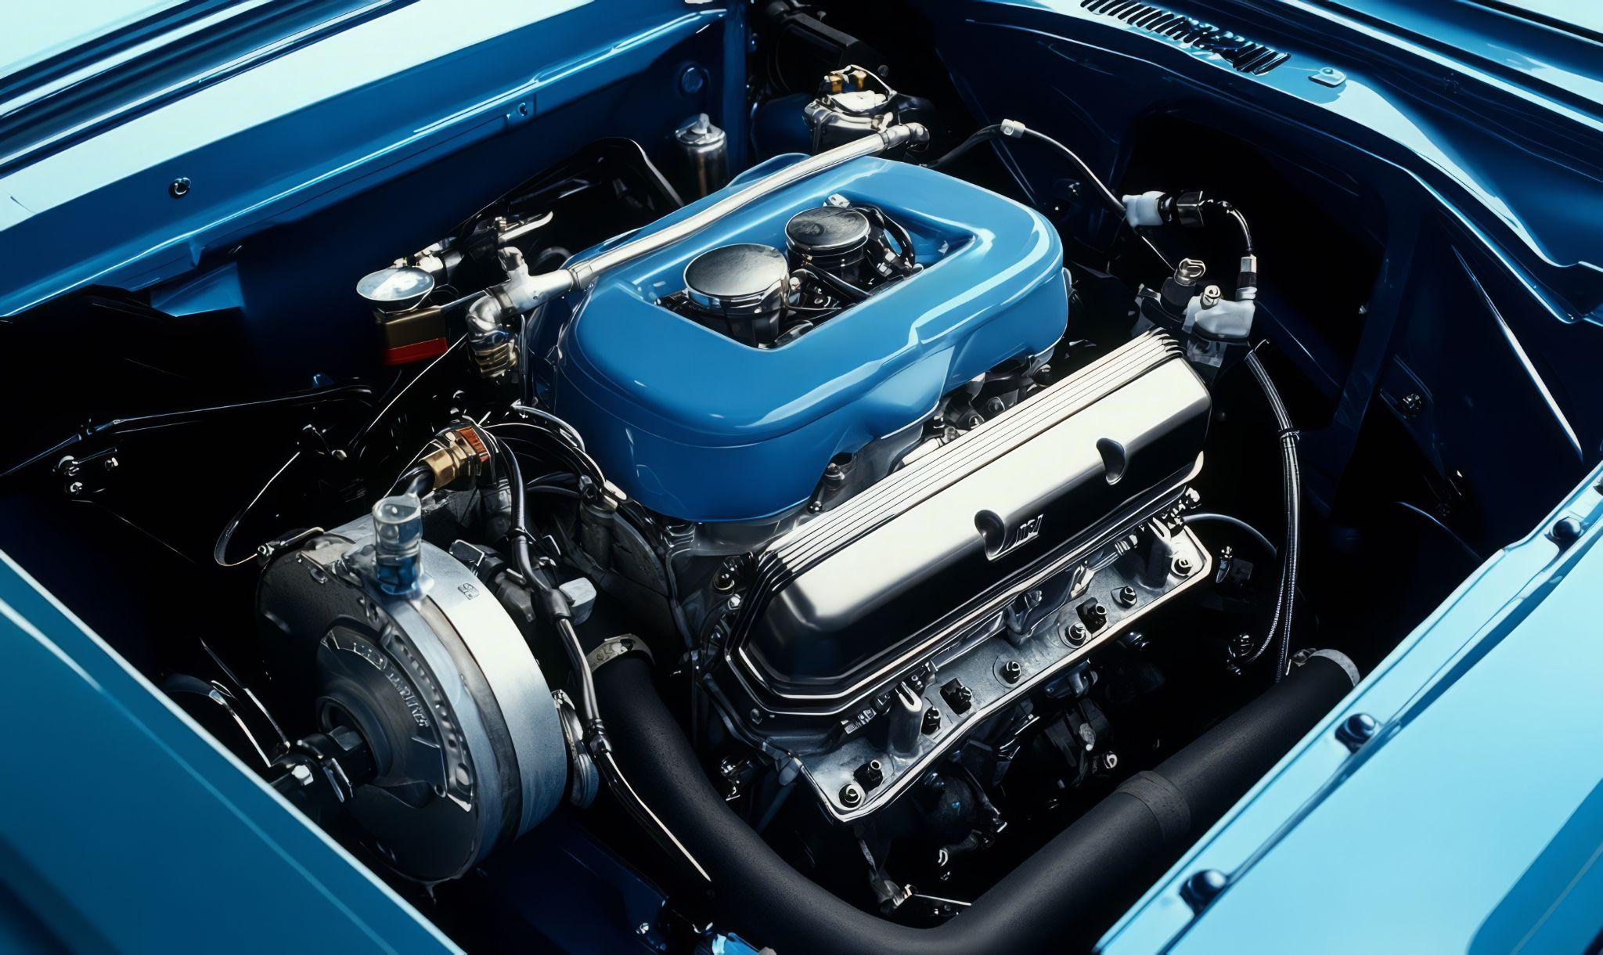
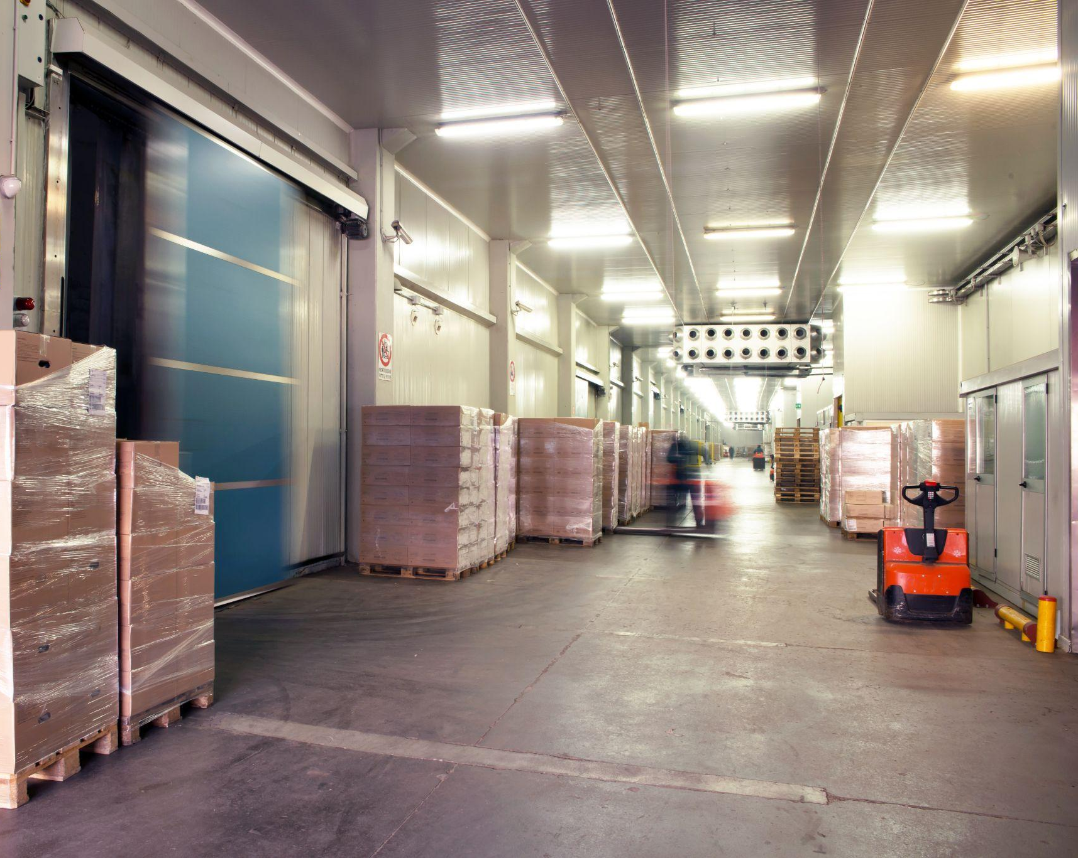
Case Studies - GridMarket Sample Projects
4 MW behind-the-meter ground mount solar for leading tire manufacturer
17MW agri-solar and 50MWH battery for autoparts manufacturer
6MW rooftop solar, carport solar, and BESS for F500 auto supplier
2MW carport solar, BESS, and EV charging microgrid for cold storage provider
Proprietary & Confidential – GridMarket 2025

