Slide 1
Addressing the Operational Challenges of the Voluntary Carbon Markets (VCM) March 2025

Slide 2
What are the operational challenges?
It depends!
1
What is the use of Carbon Credits for your company?
How do you classify the Carbon Credit instrument?
2
3
What are the risks associated with the use of Carbon Credits?

Slide 3
Carbon Credit Lifecycle Risk Assessment
Lifecycle
PHASES
Project initiation
Project validation
Credit issuance
Credit trading and management
Credit retirement
Project monitoring
Political and policy risk
Delivery risk
Quality risk
Audit risk
Audit risk
Audit risk
Pricing risk
Market fragmentation risk
Adapted from: Balancing risk and impact in the carbon market (ceezer.earth)
Notes:
Market Risk
Mark to market
Risk factors that affect the price
Counterparty Risk
Counterparty Risk
Project Developer due diligence
Credit Risk
Invoice based, pre-funded account, DvP
Exchanges, Matched Principal, Brokered, OTC
Reputational Risk
Due diligence, independent quality assurance
Narrative and disclosure
Auditability, traceability and monitoring
Operational Risk
Standard taxonomy, common definition model, harmonization across standards and rating agencies
Pre-trading, trading, post-trading
Contracting and settlement
Cyber Risk
Security Posture: minimum controls, monitoring, incident response
Resiliency (e.g. Registries, Market Data, etc.)
Regulatory / Legal Risk
What are the liabilities?
Green claims
Capital reserve requirements?
Tax implications

Slide 4
Operationalization of Carbon Credits
Lifecycle
3 – LEVERAGE NETWORK, DATA PROVIDERS & SERVICES
1 - CORPORATE STRATEGY
2 - OPERATIONALIZATION
Buyers
Sellers
1.1 - PLEDGE NET ZERO
Corporates
Governments
Fis
MULTI-REGISTRY ACCOUNT
RISK MANAGEMENT
Member Banks
1.2 - EMISSIONS ACCOUNTING
In-house team
Consultants
Software
PORTFOLIO MANAGEMENT
REPORTING
Registries
Corporate Buyers
RETIREMENT
TRADING
Supply Aggregators
MONITORING
SETTLEMENT
Brokers
1.3 - REDUCTION STRATEGY
Mitigate
Compensate
Invest
Asset Managers
AML / KYC / KYS
ACCOUNTING
Data Providers
Adapted from: Giving (carbon) credit where it’s dueCommentShareCommentShare (ctvc.co)
Notes:
Add partners on the point 3
- CARBON CREDITS
Registries
Project Developer
Project Owners
- INDEPENDENT DATA
Market Data Providers
Data Analytics
Rating Agencies
- MARKET ACCESS
Exchanges
Marketplaces
Brokers
- ADDITIONAL SERVICES
Insurance
Independent Due Diligence & Advisory

Slide 5
Scaling the Voluntary Carbon Markets
Carbon Credit Management
One Account, Multiple Registries
Access and Autonomy to the Carbon Market
Multi-Registry Carbon Portfolio Management
Gateway for financing structures for sellers and buyers
Infrastructure for trading and settlement
Platform Governance
Strong Governance in line with requirements of regulated customers
Marketplace
Advanced and sophisticated platform with flexible trade flows
Settlement & Off-Platform Trades
Bank-grade Settlement Systems provides Efficiency and Trust in VCM
Reporting & Audit
Control and management of VCCs with auditable record

Slide 6
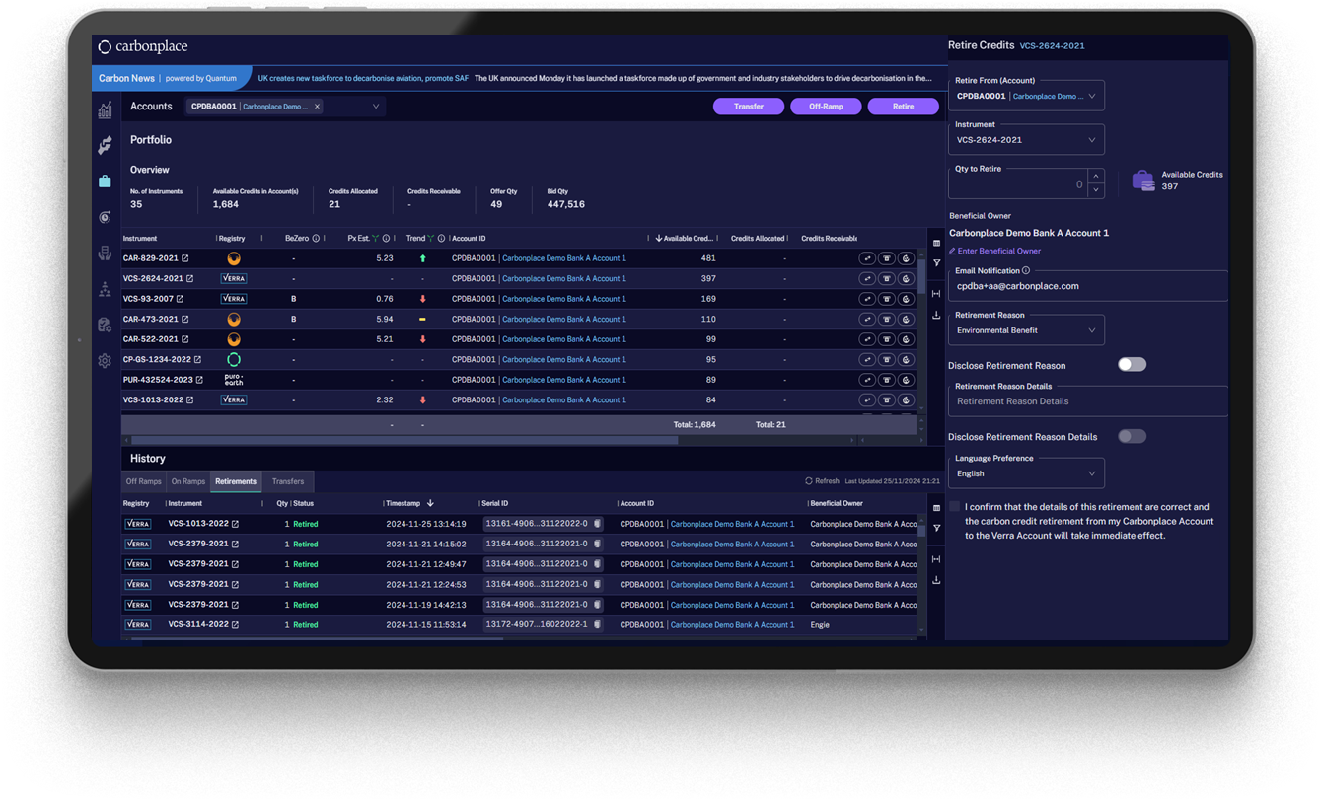
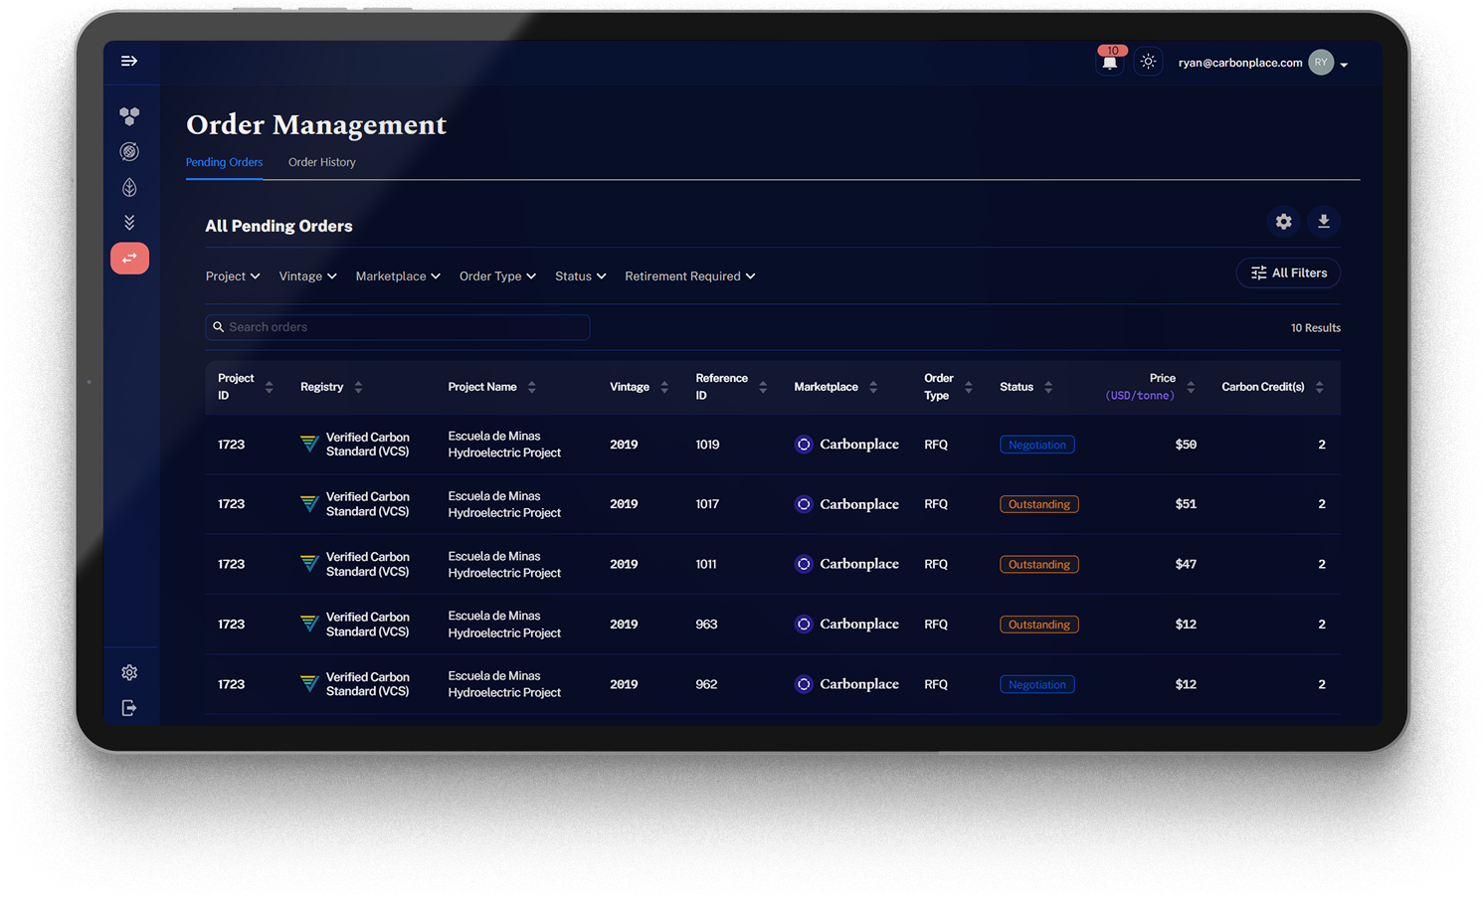
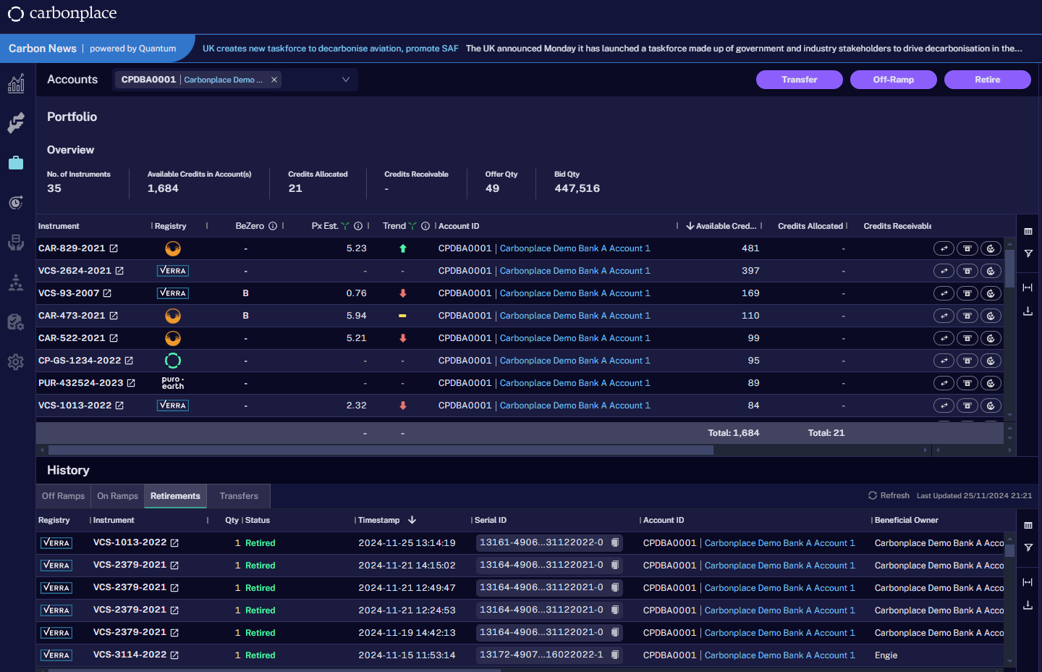
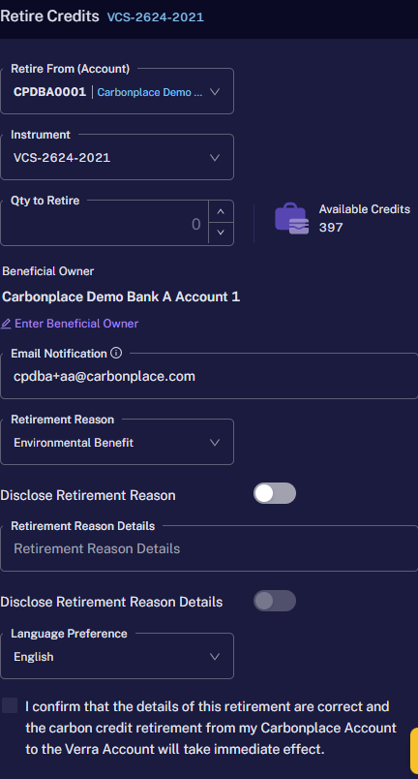
One Carbonplace Account, Multiple Registries
Your Carbonplace account will provide access to projects across multiple registries, allowing you to build a diversified portfolio.
Consolidate your portfolio in a centralised location, maintaining legal ownership of the credits throughout their lifecycle.
User-friendly UI provides standardised project information, allowing you to manage, transact, or retire your credits with ease.

Slide 7
Addressing the Operational Challenges of the VCM
Takeaways
Identify the desired use of Carbon Credits and classify the instrument in order to manage it effectively
Identify, assess and treat the risks in the entire Carbon Credit lifecycle
Consider a platform that aggregates essential and independent data
Leverage services to get access to the desired registries, allowing a centralized portfolio management of credits, supporting your operations front to back
Provide transparency to stakeholders with ​efficient reporting (e.g. project details, price, retirement certificates, etc.)
Leverage an interconnected network to facilitate KYC/AML and settlement

Slide 8
Questions?

Slide 9
How to join Carbonplace?
Onboarding is simple, we aim to make the process as easy as possible for all new members and you will have a dedicated Relationship Manager to support you at every step.
Please email sales@carbonplace.com to find out more about joining the platform.

