Slide 1
Evolving landscape of sustainability reporting
March 2025

Slide 2
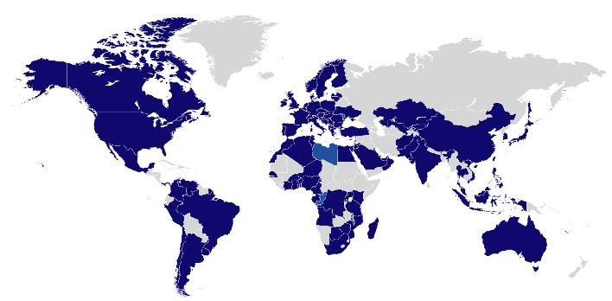
Good morning
Phuong Gomard
2

Slide 3
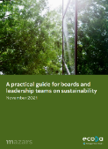
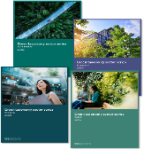
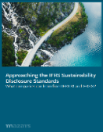
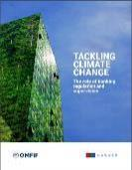
Research and publications
We have been at the forefront of providing thought leadership around various sustainability-related topics.
Deep dive into the first Omnibus on sustainability
Benchmarking sustainability practices of banks and insurers globally
Practical guides for Boards and leadership teams
Benchmarking on default probability estimation methods for climate risks
Green taxonomy series – spotlights on four sectors
Practical insights on implementing IFRS S1 and S2 disclosures
Explores stages of addressing the ESG data challenge
Central Banks surveyed on their guidelines for dealing with climate change
We contribute to the development of ESG regulations and are strongly involved in working groups on industry best practices.

Slide 4
Quite an eventful road…
Proliferation
Ambition
Opposition
Interoperability
Confusion
Consolidation
Harmonization
Simplification
Prioritization

Slide 5
Assurance
Materiality
Thresholds
Timeline
Performance
Proportionality
Controls
Data points
Greenwashing
Readability
Sector-specific
Forward-looking
Comparability
5

Slide 6
Reduce the burden and protect competitiveness
The European example
Need to protect economic competitiveness:
Streamline / Consolidate / Eliminate overlapping regulations
Address disproportionate requirements
Allow more time
Shift focus to most harmful activities
CSRD
CSDDD
EU Taxonomy
CBAM
Less ESG data from fewer companies
EU Omnibus package “Simplified Sustainability Reporting Directives”
Greater focus on quantitative disclosures
More time to adapt to the new rules
Stop the Clock – on reporting deadline delays
Substantive changes to the CSRD and CSDDD
Notes:
99% of emissions still covered

Slide 7
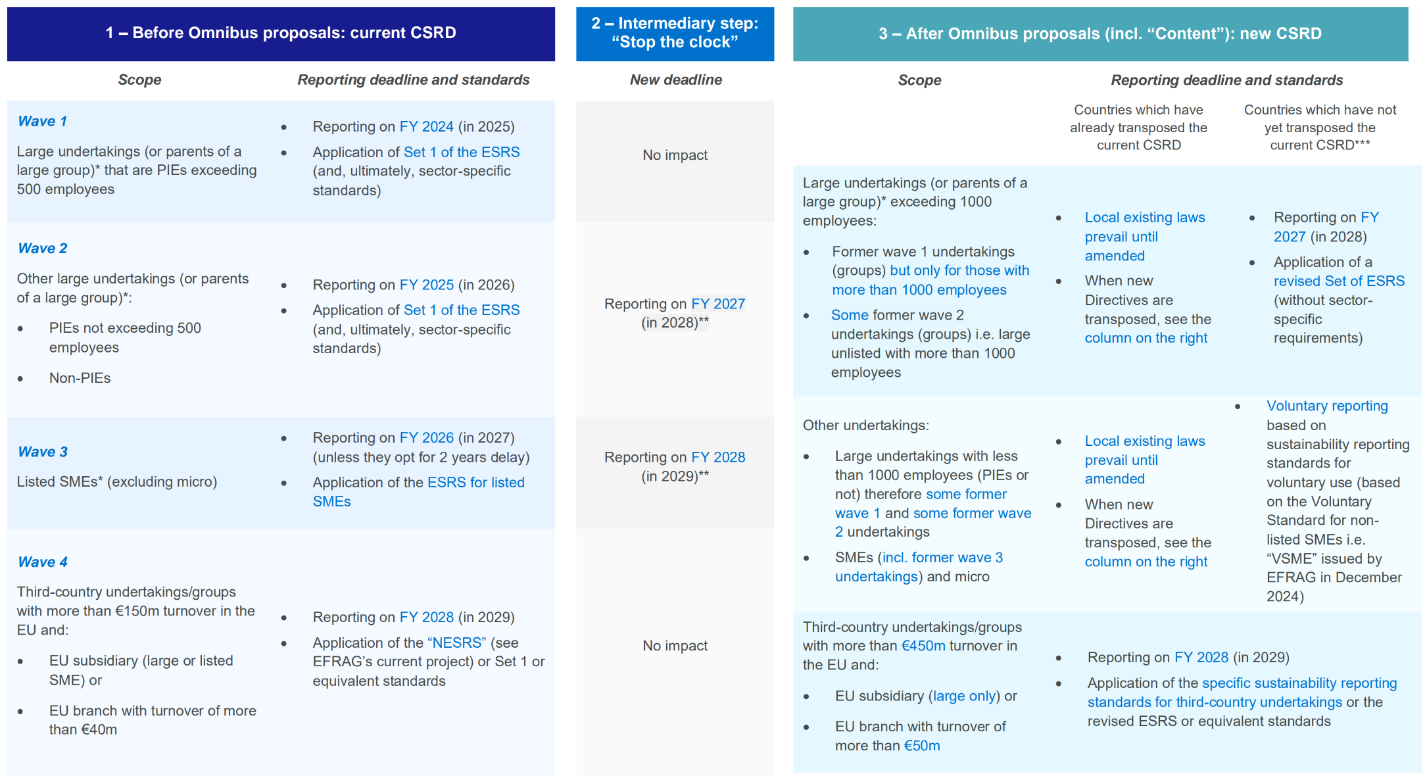
Reduce the burden and protect competitiveness
The European example
Existing Directives are not fundamentally revamped
The proposals stick to the substance of the existing regulations
There is no backtracking on sustainability commitments
* Including non-EU issuers listed on an EU regulated market
** For countries which have already transposed the current CSRD, local existing laws prevail until amended
*** Assuming the current CSRD is not transposed before the entry

Slide 8
Anticipate the emerging rules
The US example
The defense of the SEC climate-related disclosure rules has been halted.
But 6 states keep moving and are introducing or have passed legislation requiring companies with $1 billion or more in revenue to report Scope 1, 2, and 3 emissions.
New York
Illinois
New Jersey
Passed
Reporting starts in 2026
Pending
Additional climate risk reporting for $500M+ revenue companies beginning in 2027
California
Pending
Reporting starts in 2027
Pending
Proposal mandates reporting from 2027
Washington
Pending
Phased-in reporting from 2027 to 2031
Colorado
Pending
Phased-in reporting starting four years post-passage

Slide 9
Keep going
Put the pen down
Revisit reporting strategy based on anticipated timeline for Omnibus approval process.
If still in scope, continue advancing methodically and take the opportunity to enhance data reliability.
Continue at the same pace
If no longer in scope, focus on value creation and business resilience, because customers and stakeholders will keep demanding more transparency and granularity.
Focus on priority matters instead of reporting
Choose to keep sight of the big picture and the long-term need to shift to more sustainable methods of economic growth
Unlock value creation by driving organizational shifts with improved sustainability performance management, governance changes, and investments within operations or supply chains

Slide 10
Face the ultimate challenge
There’s reporting and disclosing, and then there’s going green…

Slide 11
Full suite of ESG & climate risk solutions
Our global economy has evolved and allowed us to accomplish amazing feats, only dreamed about in generations past. We have changed the way we do business, the way we live, and how we interact with each other. At the same time, our interconnectedness as a global society has caused our symbiotic relationship with the planet to become taxed. Some of our greatest societal achievements have also led to some of our greatest future risks. Our offerings are designed to help clients achieve their goals in the backdrop of this new ESG landscape and contribute to the betterment of the world for generations to come.
Climate risk management
Climate Risk and Opportunity Assessment
Risk Management Process Integration
Supply Chain/Third-Party Risk Management
Climate Quantitative Solutions – Physical/Transition Risk Modeling and Validation
Scenario Analysis and Stress Testing
Climate Risk Data Strategy
Climate Risk Appetite Statement
Business Continuity Planning
Climate Change Adaptation
ESG strategy & governance
ESG Materiality Assessment and Stakeholder Analysis
End-to-End Program Design and Management
Framework Assessment and Alignment
Executive and Board Training and Education
Sustainability Communications and Marketing
ESG Strategic Development
ESG Data and Technology Architecture Strategy
ESG Policy Development
Corporate data & reporting
ESG Data Sourcing Strategy
ESG Internal Controls Readiness and Assurance
Sustainability Reporting Copy and Design
Data Governance and Data Quality Implementation
ESG Data and Reporting Software Selection/Implementation
Regulatory Disclosure Support and Requirements Management
Sustainability KPI Identification and Dashboards
ESG-centric advisory
Circular Economy and Resource Efficiency Management
Diversity, Equity, and Inclusion (DEI) Assessment
Corporate Social Responsibility (CSR) Development
Environment, Health, and Safety (EHS) Support
ESG Investment Policy and Process Development
Life Cycle and Impact Assessments
Sustainable Finance Methodology and Strategy
B Corp Assessment and Certification Support
Carbon Credit Advisory
Capital and Green Financing Advisory
Sustainable performance improvement
Carbon Accounting (Scope 1, 2, & 3)
Market Insight and Performance Analysis
Peer Benchmarking and Competitor Analysis
ESG Ratings Review and Management
Sustainability Goal Setting
Net Zero Strategy and Decarbonization Pathways
Science-Based Targets Initiative (SBTi) Submission Support
GHG Emissions Reduction Strategy
11

Slide 12
Phuong Gomard
Principal
phuong.gomard@us.forvismazars.com
forvismazars.com

