Slide 1
EXPLORING
THE CLIMATE FUND LANDSCAPE
with Todd Khozein,
Co-Founder & CEO, SecondMuse

Slide 2
About Us
WHO WE ARE
& OUR IMPACT
33,000+ solutions prototyped
2,100 ventures supported
185 countries & territories reached
$19 million in non-dilutive capital
$1.2 bn+ influenced
$880m in direct investments.

Slide 3
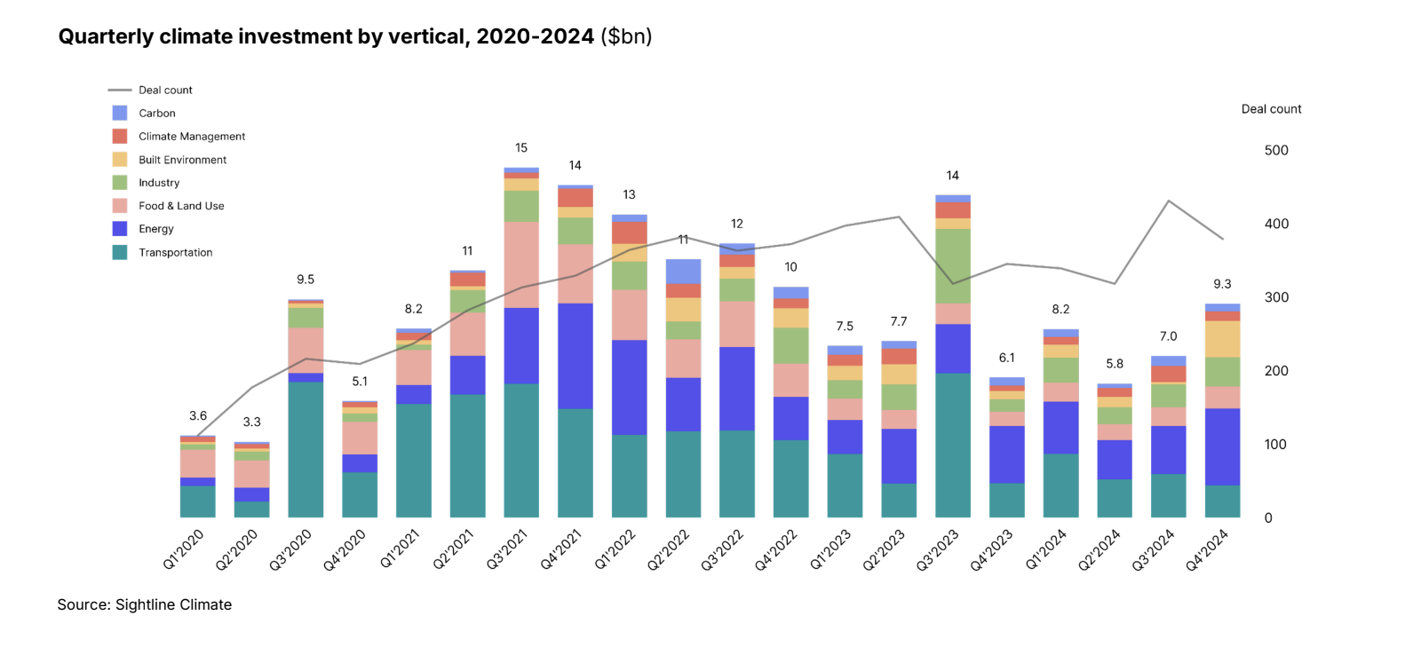
CURRENT INVESTMENT TRENDS

Slide 4
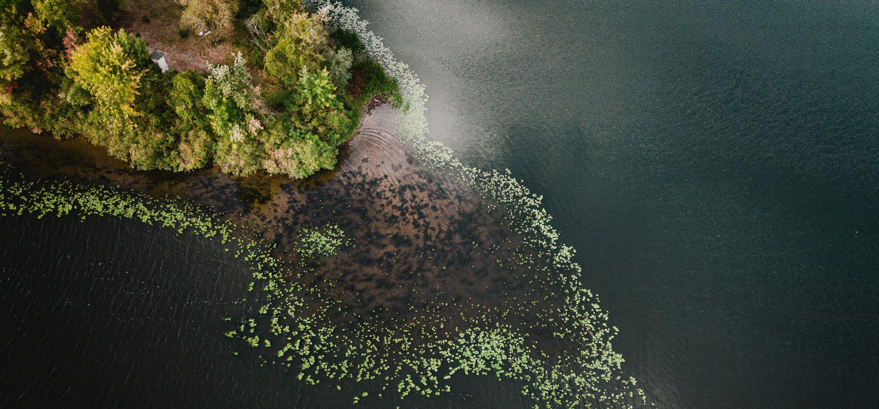
THE RISE OF SYSTEMS FINANCING
Notes:
he Sc

Slide 5
UNLOCKING STATE FUNDING FOR INNOVATION
Supported by NYSERDA Administered by NextCorps and SecondMuse
86+ companies supported
$50 million in revenue generated
$500+ million raised
35,000+ units produced

Slide 6
DEPLOYING TAILORED FINANCIAL MECHANISMS FOR MAXIMUM IMPACT
Supported by Empire State Development
and SecondMuse
A tailored $50m fund to support small business owners provide a mode of transportation that up to 20% of new yorkers rely on by reducing risks, costs and emissions.

Slide 7
LEVERAGING INNOVATIVE FINANCING AND A MULTI-SECTORAL APPROACH
The Coral Reef Financing Facility (CRFF)
Addressing the urgent need for sustainable coral reef restoration in key marine ecosystems by establishing a locally grounded financing model.

Slide 8
Together, we can scale transformative solutions, accelerate the transition to a sustainable future, and unlock the full potential of climate finance.

Slide 9
Section 3
Q&A

Slide 10
LEARN MORE
secondmuse.com | @secondmuse | hello@secondmuse.com

