Slide 1
Wall Street Green
March 19, 2025

Slide 2
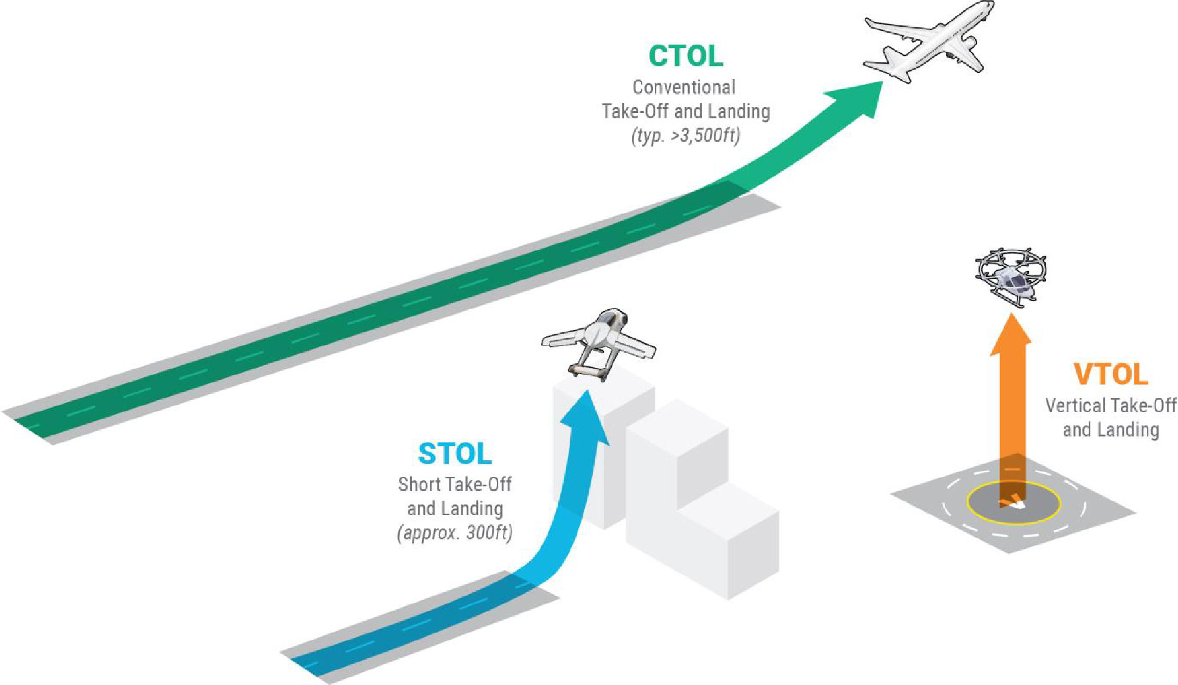
Electric Aviation:
Advanced Air Mobility
Rapid technological advances in propulsion and electrification are changing our airspace.
CTOL
EVTOL
DRONE
Advanced Air Mobility (AAM) is the integration of innovative aircraft into existing and new airspace systems to enable efficient, sustainable, and scalable transportation of passengers and cargo.
Credit: FlyOhio

Slide 3
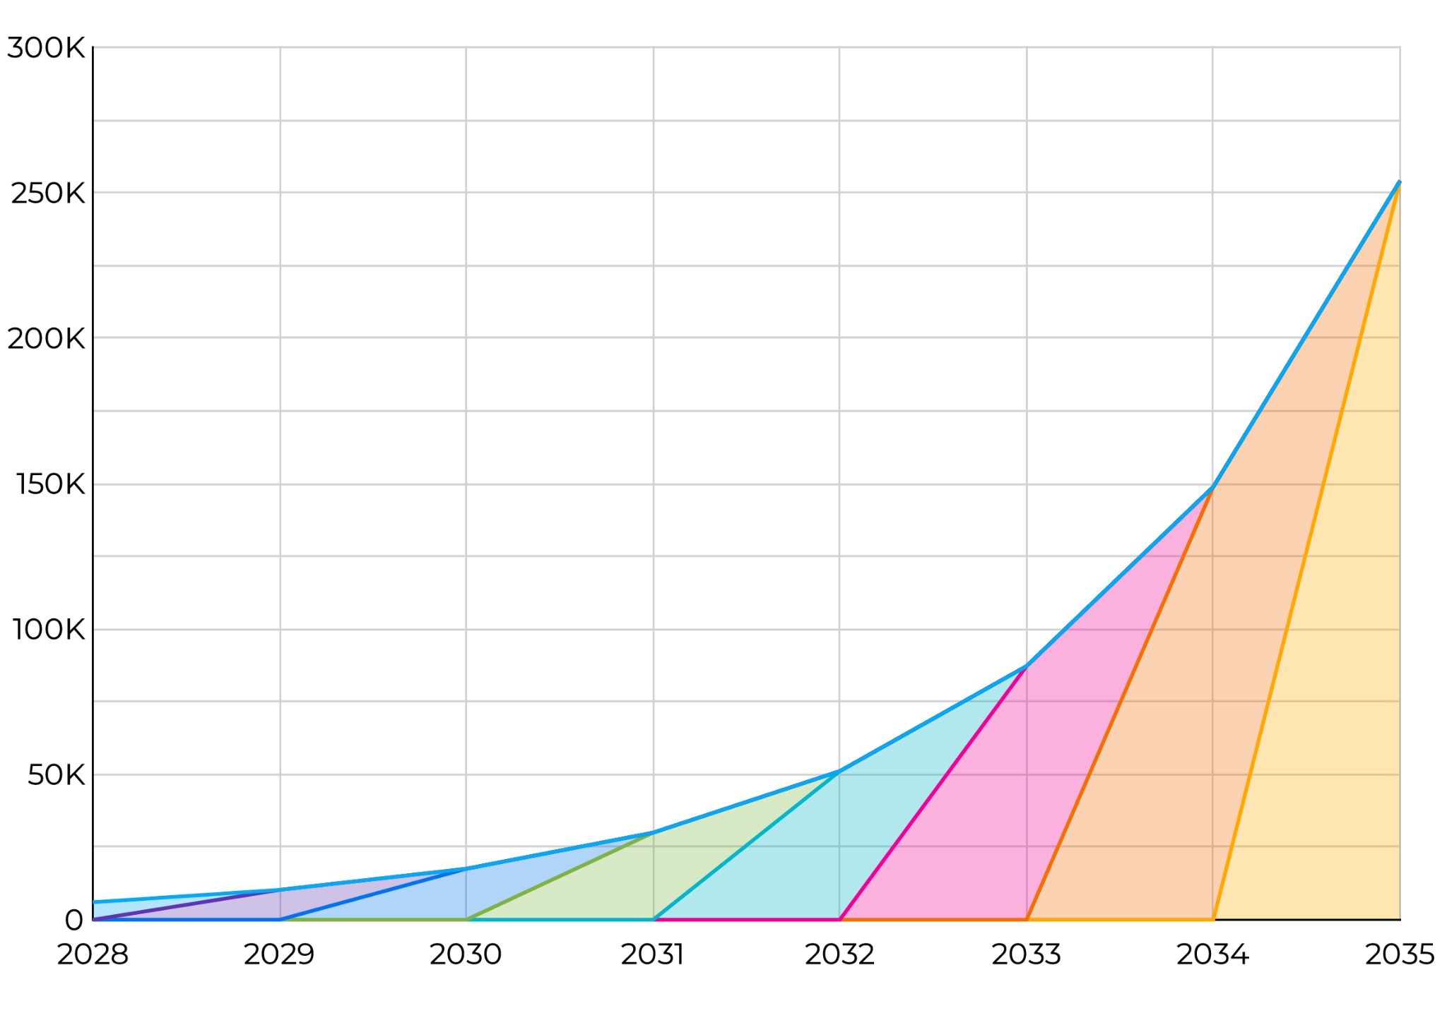
Electric Aviation:
What if eVTOL’s scale like EV’s
Between 2010 and 2017 EV production in North America scaled from less than 5,000 to over 200,000 vehicles per year.
eVTOL’s production rates are expected to grow similarly to EV’s and not like conventional aircraft.
EV charging stations, however, has lagged by 4 years. Today there is one public charger per 20 EV’s.

Slide 4
Electric Aviation:
Advanced Air Mobility is Here
…but there is no place to land
Expected Entry into Service
Capital Raised to Date
Archer
2025 (USA/UAE)
$3.36B
600+
Electric Vertical Take-off and Landing aircraft designs
Beta
2026 (USA)
$1.2B
eHang
2024 (China)
$138M
400K
Commercial Drones registered (US)
EveAir
2025 (Brazil)
$2.6B
2024
FAA final ruling on Power-Lift aircraft Re-authorization Act for Flight Paths
Joby
2025 (USA/UAE)
$2.6B
SkyDrive
2025 (Japan)
$300M
2030
Over 19,000+ eVTOL aircraft are scheduled to be delivered
Vertical
2028 (UK)
$545M

Slide 5
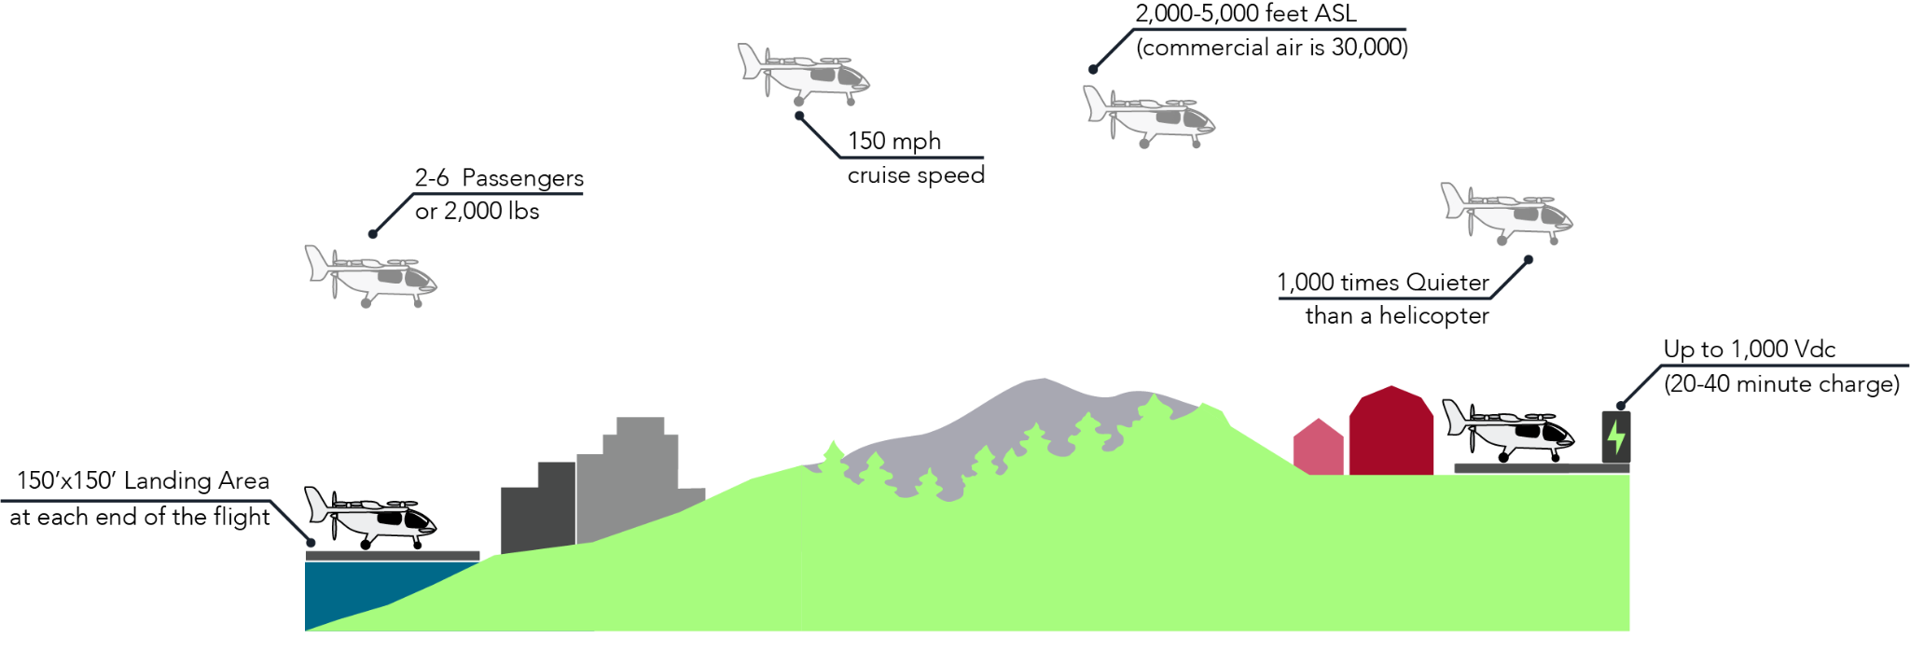
Sustainable Aviation:
Clean, fast, quiet regional transportation
AAM leverages emerging technologies such as electric vertical takeoff and landing (eVTOL) aircraft and their ability to land in small areas, to enhance regional mobility, reduce emissions by 70%, and improve access to underserved regions.
Urban Network
64 sites
(Blade, Uber, Joby Archer)
Rural Network
2,000 sites
(Landings)
Battery range +/-120 miles

Slide 6
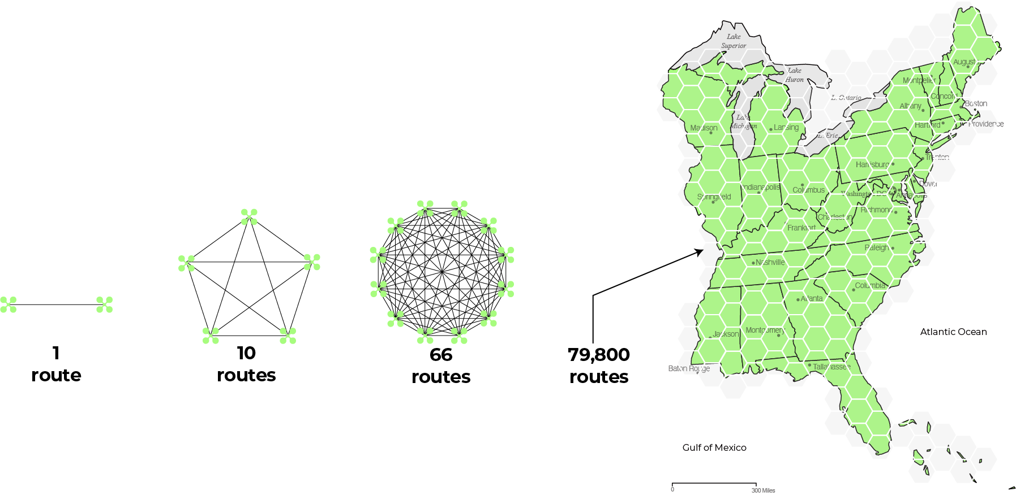
Solution:
The Landings Network™
We are building a network of landing, charging, and ground operations with no point more than 30 minutes from a vertiport
Our North American network consists of over 2,000 vertiports stretching from Canada to the Caribbean.
The value is the network
(eastern network 400+ nodes)
Metcalf’s Law:
The value of a network grows exponentially proportional to the square of the number of nodes.

Slide 7
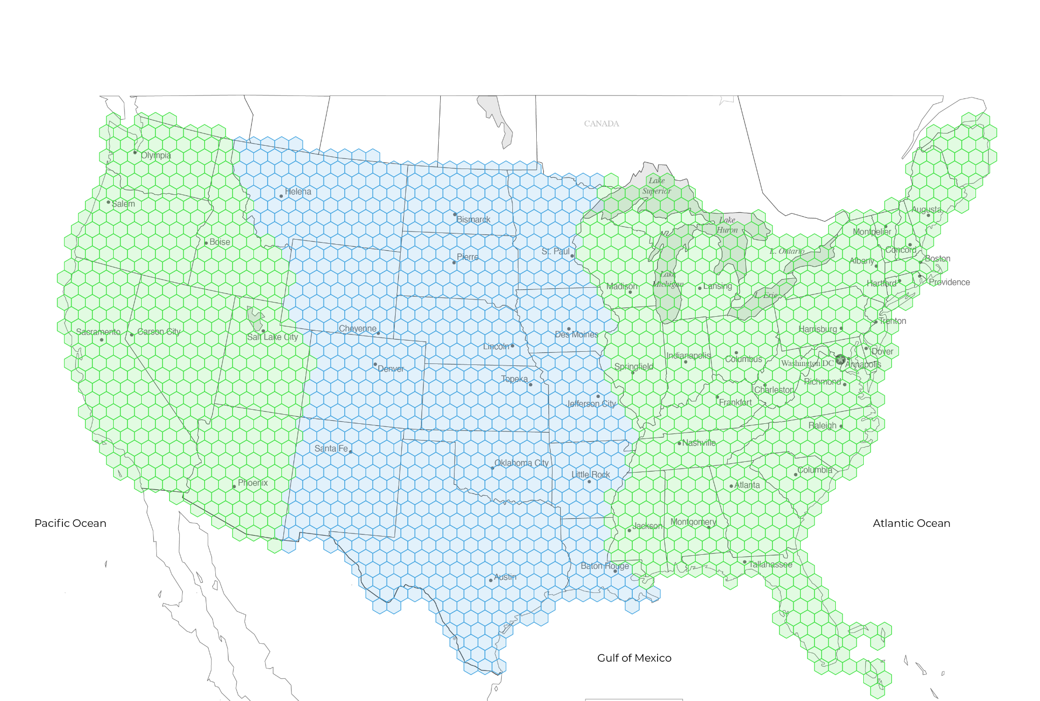
2,000+ Vertiports:
East, West, and Center
Phase III
Phase I
Phase IV
Phase II

Slide 8
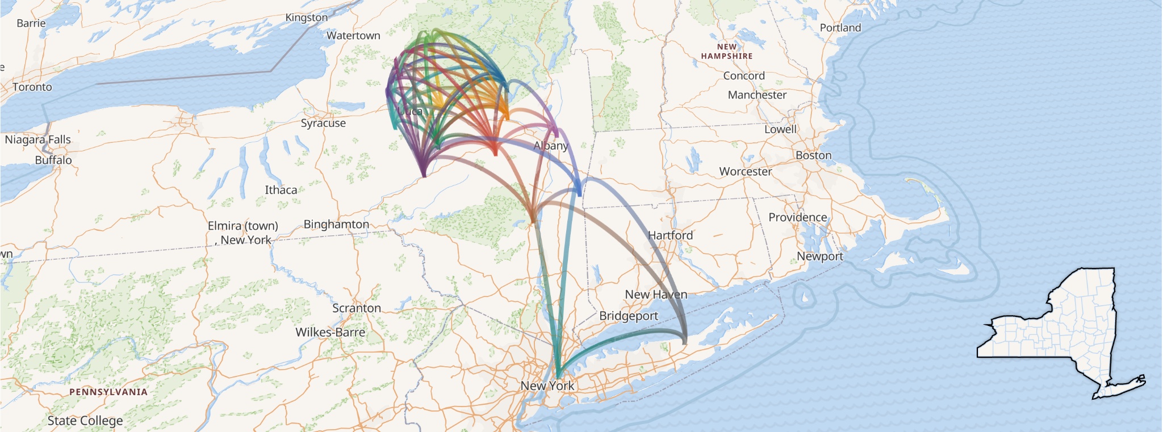
Phase I:
Connecting the Mohawk Valley to New York City
Turning around the population decline will require a concerted regional effort that networks communities together and encourages development to “leapfrog” the environmentally sensitive Catskills. (Places Institute, 2023)

Slide 9
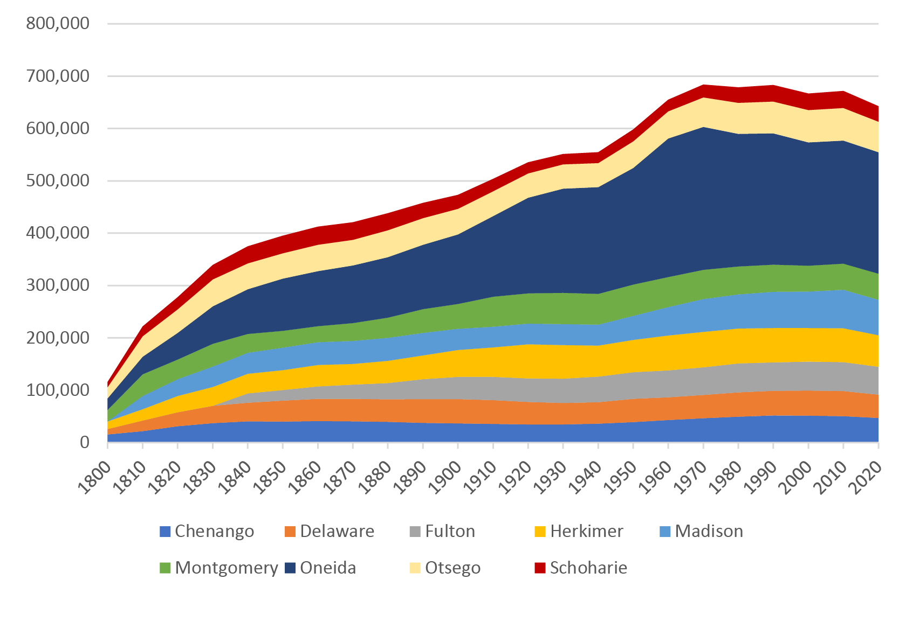
Phase I:
Economic and Demographic Challenges in Rural New York
The most promising opportunities for population growth are incentivizing college students to stay, providing better access to medical for the over 65 population, and converting part-year residents to full-time.
5%
of total population is enrolled in college
25%
of total population is over 65 years old
30-40%
of households are seasonal

Slide 10
Benefits:
Vertiports Support Sustainable Communities
A Landings vertiport is good for the community and good for the property owner.
Retain Existing Residents
by bringing emergency and medical care to them
Attract New Residents and Employers
remote workers and new employers create work hubs
Increase Land Values
with multimodal transportation network adjacency
Local Workforce Training
local talent is required to operate the network
Upgraded Energy Resilience
AND increases the value of the Urban networks too!
Unlike Urban networks, the Landings Rural network is not adding another means of transportation (subway, bus, Uber, Blade), but instead providing a vital new connection to formerly remote places.

Slide 11
Case Study:
Bringing Medical Treatment Closer
The dialysis center in Amsterdam is near the highway, yet some patients drive up to 2 hours each way.
To | Flight Miles | Flight Minutes | Drive Miles | Drive Minutes
Northville | 19 | 10 | 25 | 37
Middleburgh | 24 | 12 | 30 | 43
Little Falls | 34 | 17 | 43 | 45
Cooperstown | 40 | 20 | 50 | 66
Oneonta | 55 | 28 | 68 | 75
Rome | 66 | 33 | 79 | 78
Waterville | 60 | 30 | 74 | 83
Boonville | 69 | 35 | 92 | 95
Old Forge | 66 | 33 | 112 | 117
This can be reduced to 33 minutes by eVTOL.

Slide 12
Rural Tech Stack:
Technology for energy resilience and flexible living
Technological advances make investing, living, and working in rural communities easier and more appealing than ever.
StarLink
Waymo
Microgrids
Batteries
Alternative Energy Sources
Low Voltage Equipment
Hybrid Work
Zoom and FaceTime
Drones and eVTOLs

Slide 13
Supply and Demand:
Bringing Industry to Rural Communities
Economic Development Organizations
Towns, Counties, and Regions
REITs
Shopping Centers, Office / Industrial Parks
Hospitality
Casinos, Hotels, Wineries, Breweries, Resorts
Medical Facilities
Hospitals, Blood Banks, Dialysis Centers
Emergency Services
Fire Departments, Emergency Services
Residential Communities
Senior Living, HOA’s
UAM/AAM Aircraft Manufacturers
Drones and eVTOL
Fleet Operators
UberAir, Wisk, Waymo
Aircraft Testing Companies
In-house and National Safety Testers
Individual Equipment Owners
Educational Institutions
Operations Training, Pilot Training
Industry Vendors
Ground Operations, Energy Products
Communities and Local Businesses
New Industry and Related Products

Slide 14
Use Timeline:
How network use and revenue will ramp up
Phase I
Phase II
Phase III
Phase IV
Drone delivery partners for future use of the network.
Early carriers (pre-eVTOL) for medical deliveries, drone, and weather dirigible launch and land.
As vertiports come online early carriers begin use, logistics partners reserve capacity, and the DoD secures rural service locations.
Regular Routes begin for eVTOL services, as regional networks are completed point-to-point service builds with demand.
Notes:
Secure 200 rights, build as

Slide 15
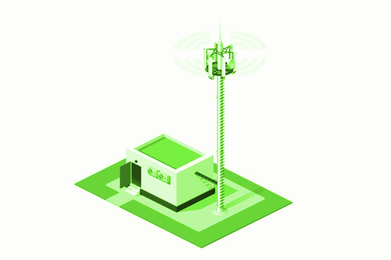
Business Model:
We aim to be the American Tower of AAM
American Tower
Founded 1995
Landings
Founded 2024
Secured cell tower sites in advance of the proliferation of cellular phones
Offers flexible contracting and revshare structure
Builds and operates tower sites
Economics substantially increase as additional carriers use the network
Site revenue derived from equipment weight, location, and network usage
Secured vertiport sites in advance of the proliferation of AAM
Offers flexible contracting and revshare structure
Builds and operates vertiport sites
Economics substantially increase as additional operators use the network
Site revenue derived from landing and charging frequency, and regional/overall network usage
42,000+ towers
(US network)
2,000+ vertiports
(US network)

Slide 16
Prototypes:
Vertiport Services and Requirements
Vertiports will be designed based on the site size, adjacencies, power availability, and network carriers.
 | verti Plex | verti Port | verti pad | verti stop
Landing Slots
Charging Stations
Passenger Amenities
Maintenance / Parking
Hospitality / F&B
Training Center
Site Area | >7 acres | 3 acres | 1.5 acres | 200’x200’
Est TO+L per day | 20 | 10 | 6 | 5/week

Slide 17
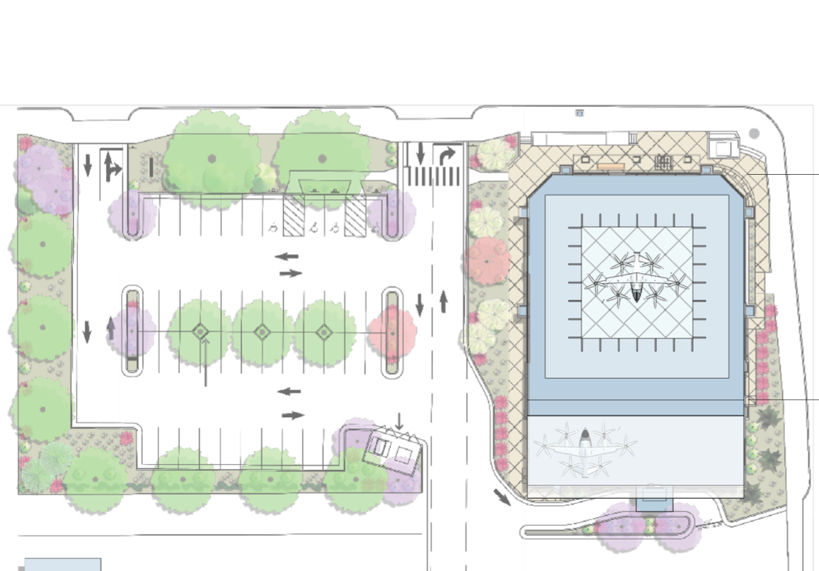
Prototypes:
Vertiport Space Requirements
This vertiport has one landing pad, one charging station and a passenger waiting area.
To give a sense of scale, the landing, charging and passenger areas are superimposed on the footprint of a standard stand alone drug store.

Slide 18
Team Key Relationships
The team has worked together for over 20 years using a software-first building methodology to realize commercial real estate and energy projects at scale for clients including Jet Linx, Port Authority NY/NJ, Uber, and American Express.
Lisa Wright
Founder
Sarah Parlow
Project Funding
Lisa is a veteran of the real estate industry with experience as the owner, developer, designer, and operator. She has realized thousands of projects for retail and commercial clients globally.
Sarah has implemented digital twins for energy projects for hotels, school districts, and private industry. Sarah specializes in project funding and energy auditing.
Paul has developed and spun off proptech solutions to scale architectural projects. Paul is a licensed architect focused on revitalizing communities.
John has completed thousands of MEP projects for commercial clients in the US. As a licensed engineer specializes in transportation and energy solutions.
Paul Bennett
Vertiport Design
John Guth
Energy Engineering

Slide 20
Appendix A
Advanced Air Mobility Progress
Landings Network
Proof of Concept
(2005-2024)
Urban Air Mobility
(2025)
Rural Air Mobility
2026
FAA Powered Lift Part 194
50+ US/Canada Aircraft
Over 10,000 test flights
Pilot Training Guidelines
Ground Operations Requirements
Existing Helipads and Airports as endpoints
High-frequency restricted urban routes
Landing areas owned by Uber/Delta/Blade
Demand for aircraft production capacity
Network of Certified Landing Areas
On-demand point-to-point flights
Vertiports operated by the network
Extensive Carrier Agreements

Slide 21
Appendix B
Vertiport Infrastructure Services
Assessment/Advising
Design/Engineering
Construction/Install
Whether converting a heliport or building from the ground up; Landings can provide support and services to get your location certified.
Feasibility Study
Demand Analysis
Amenities Assessment
Regulatory Review
Stakeholder Engagement
Preliminary Site Survey
Infrastructure Assessment
Preliminary Budget
Estimated Revenue
Grant and Funding Options
Detailed Site Survey
Vertiport Layout Design
Building Submittals
Charging/Refueling Infrastructure Design
Vertiport Automation System
Ground Operations Facilities
Safety and Security Systems
Project Budget
Utility Tie-ins
Infrastructure Installation
Equipment Financing
Modular Financing
Co-op Agreements
Site Preparation
Building Permits
Vertiport Construction
Equipment Installation
Concessions Installation
Testing and Commissioning

Slide 22
Appendix C:
The Landings Network
Operations and Maintenance
Network Revenue Share
Fees and Charging Revenue
Billing & Payment Processing
Slot Management & Scheduling
Site Automation & Access Control
Portal, Mobile, & API Access
Staffing and Training
Ongoing Maintenance
Real-time Performance
Monitoring Safety and Security
Ongoing Regulatory Compliance
Specialty Insurance
Updated Operational Procedures
Discounts & Early Access to Emerging Technologies

Slide 23
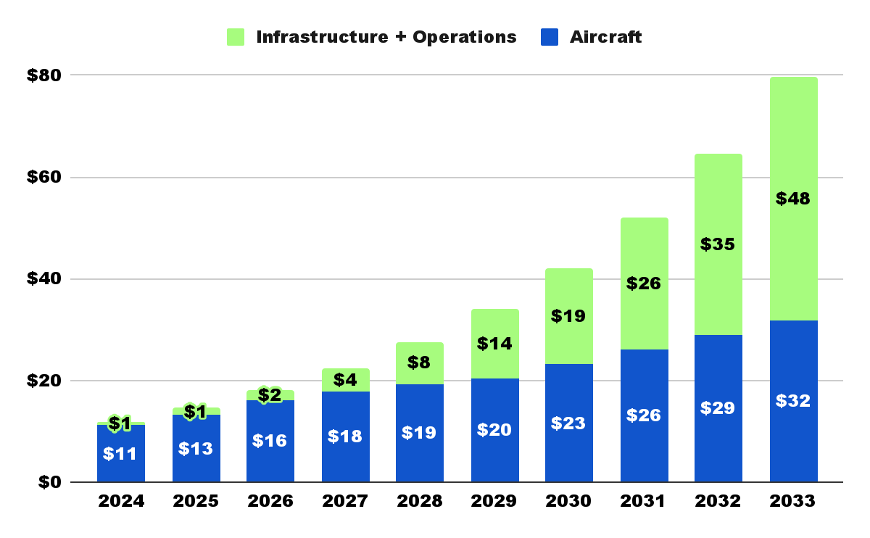
Appendix D
AAM Growth Forecast
Over the next 10 years the AAM market is expected to grow at a CAGR of 23.3% to reach US$ 79.7 billion by 2034*.
Increasingly, Infrastructure and Operations will make make up the majority of the value.
The US and China will lead market share with about 40% each by 2034.
*Prophecy Market Insights, Global Forecast Report on Advanced Air Mobility Market, 2024-2034
Notes:
Deloitte projected the US AAM market to be $115B by 2034, so I am using the more conservative projections.

Slide 24
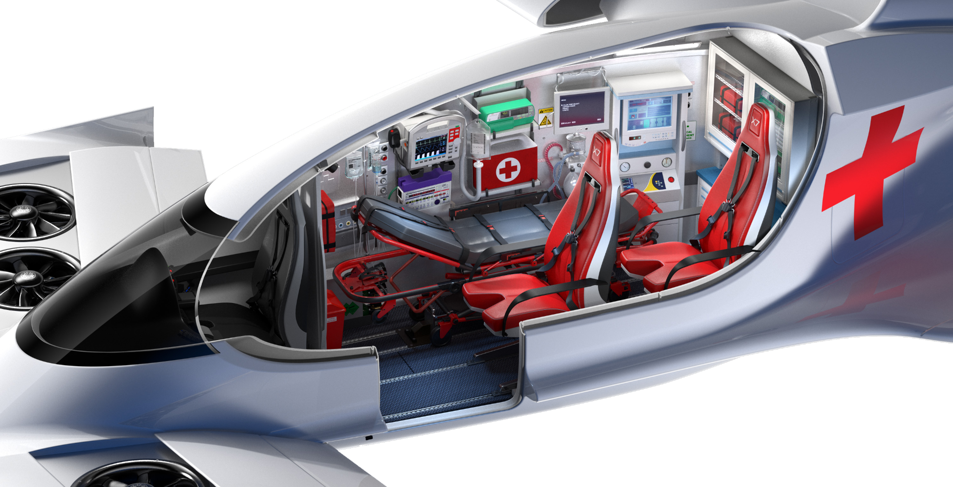
Appendix E
EMS Prototype

Slide 25
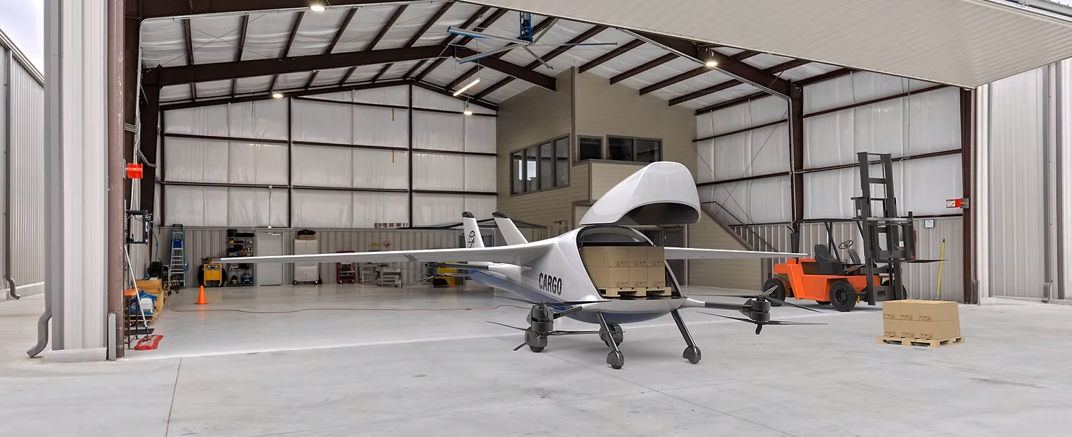
Appendix F:
Autonomous Logistics

Slide 26
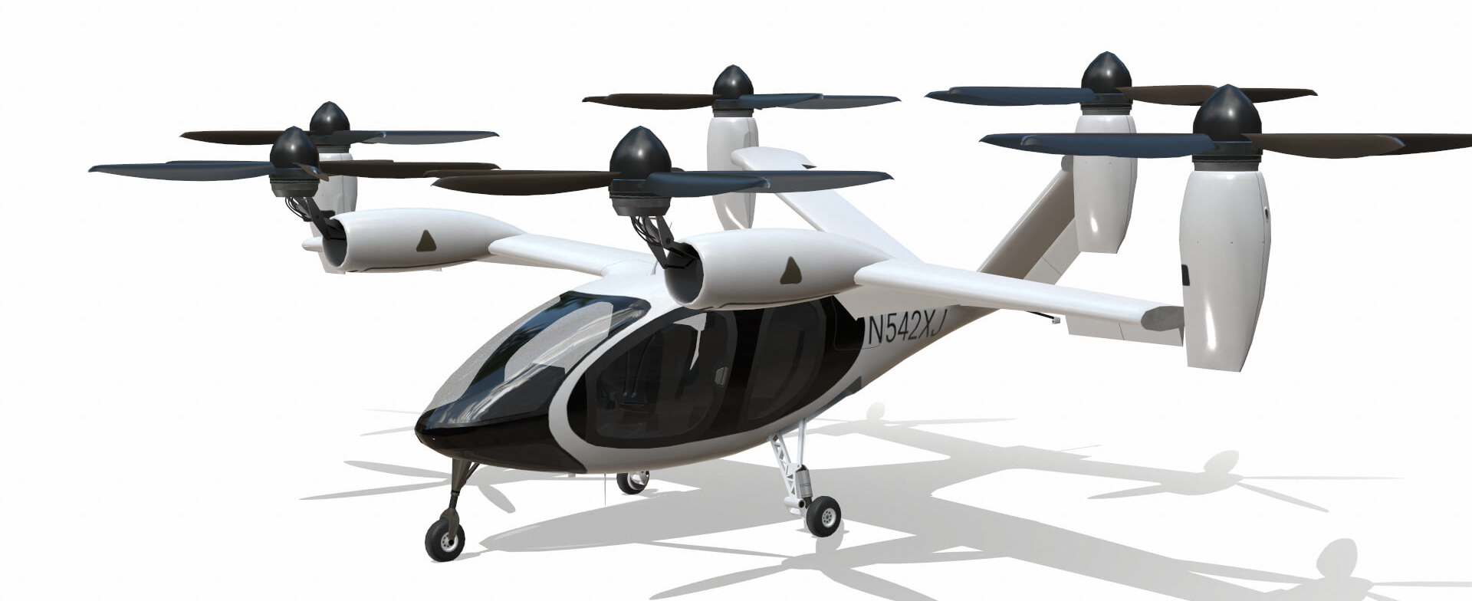
Appendix G:
Joby Air Taxi

Slide 27
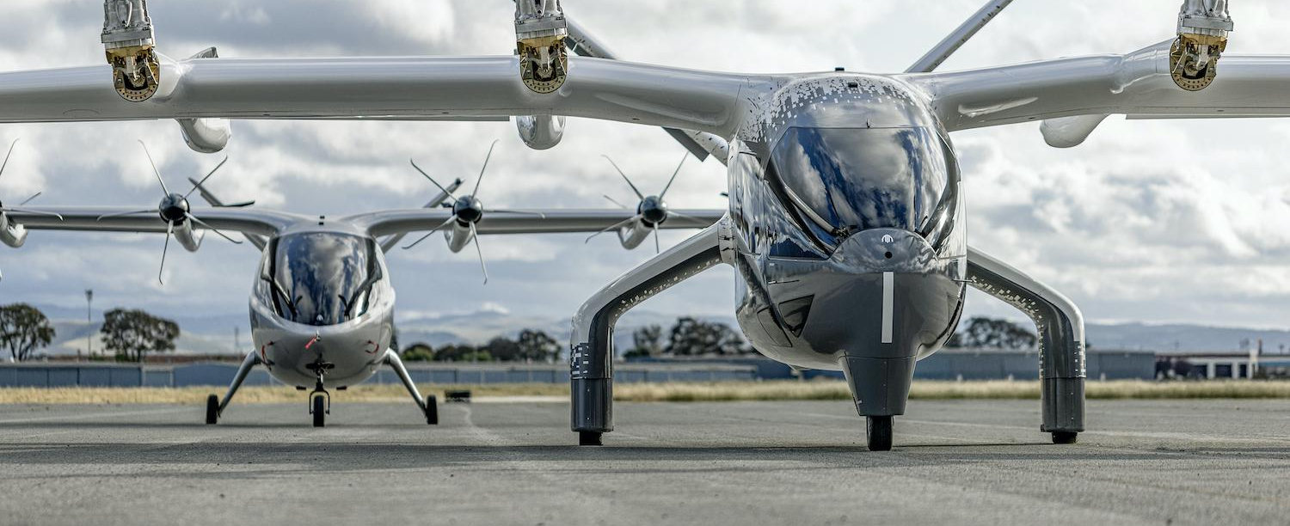
Appendix H:
Archer Air Taxi

Slide 28
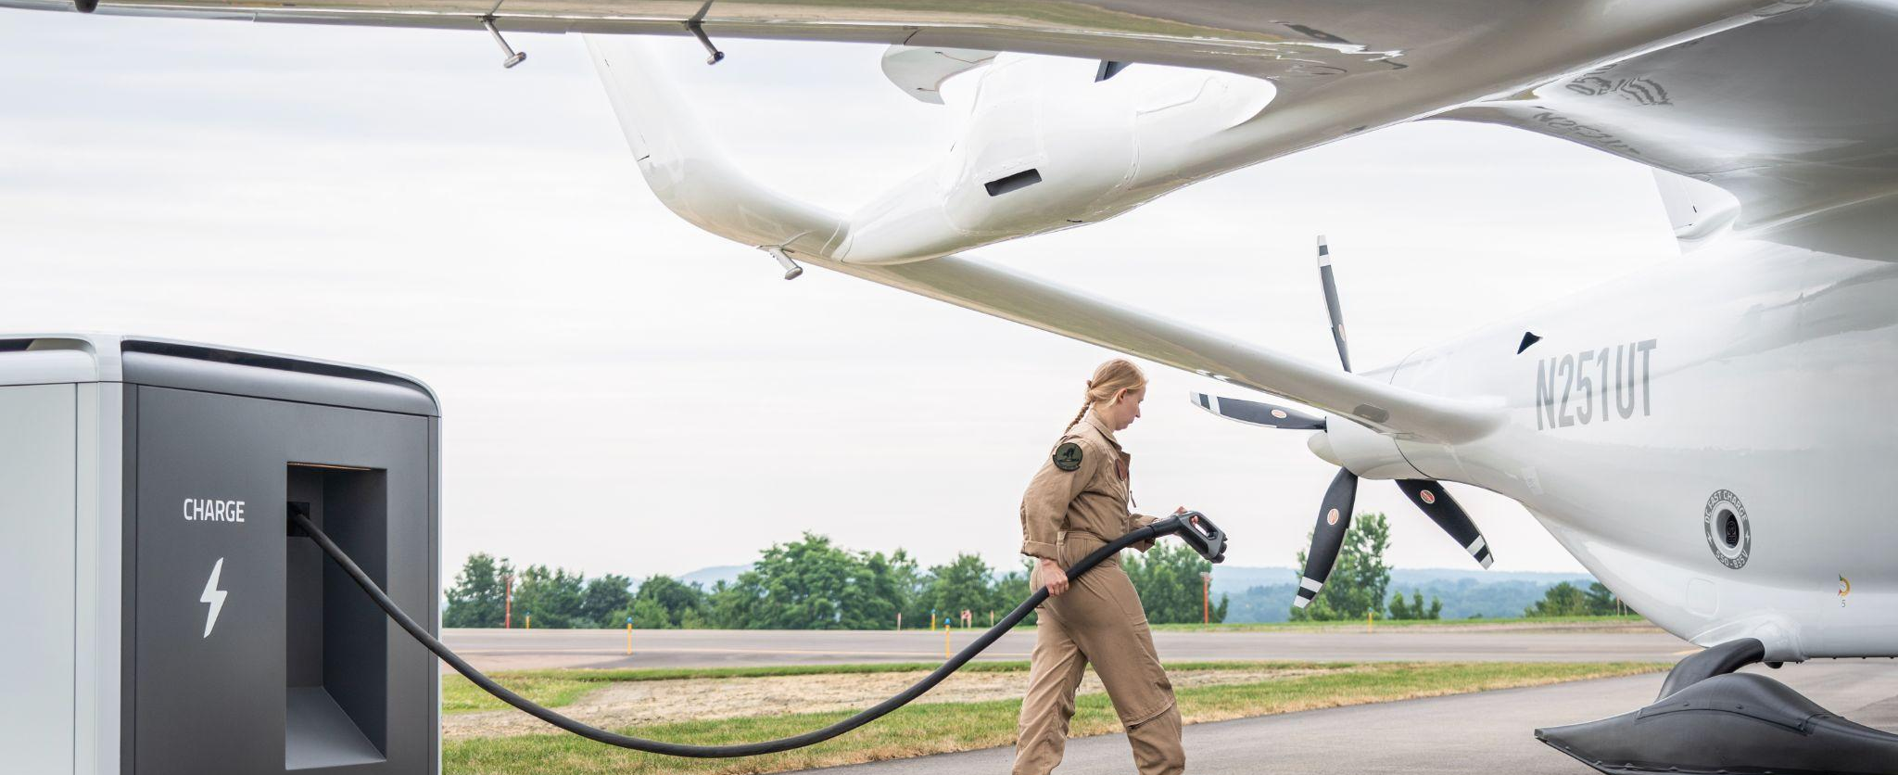
Appendix I:
Beta Charging Technology

