Slide 1
Home Electrification @ Aurora Solar
A Strategic Outlook on the Future
Creating the future of solar for all.

Slide 2
About Me
Experience
Climate software investor
B2B software investor & operator
10+ years in climate & industrials
Education
MBA focused on finance & entrepreneurship
B.S. in Electrical Engineering
Jarell Mason
Partnerships & M&A
Personal
Originally from the US Virgin Islands
Fun Fact: Lakers fan

Slide 3
Presentation Contents
01
Background: What is home electrification?
02
Market: How is the market shaping up & why now?
03
Problem: What are the biggest blockers for home electrification adoption?
04
Aurora’s Solution: How is Aurora tackling these problems?
05
Predictions: What will need to be true for mass adoption of home electrification technologies?
06
Questions

Slide 4
01
Background

Slide 5
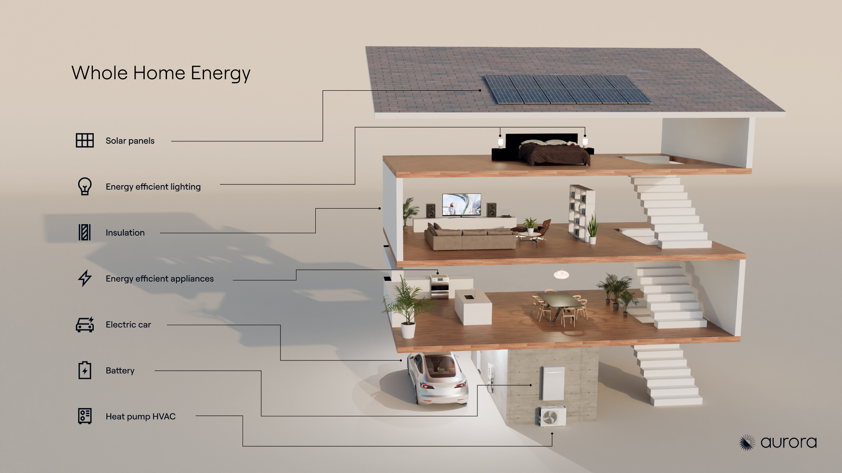

Slide 6
02
Market

Slide 7
Market | How is the market shaping up & why now?
Rising Adoption Rates
Utility rates continue to increase, moving consumers to seek energy independence
Electrification products are becoming more mainstream
As of 2023, 1.2 million homes installed electrification products such as rooftop solar
In Q1 2024, batteries were attached 25% of the time with solar installations
Evolving Policies & Incentives
Inflation Reduction Act’s home electrification incentives under scrutiny
State policies like the All-Electric Buildings Act (NY) and the California Advanced Homes Program (CAHP) are becoming increasingly vital amid sweeping federal policy changes
Increasing financial viability
A newly constructed electrified home in the U.S. saves homeowners on average $130 to $540 annually compared to legacy homes
Source(s): Financial Times, Solar Power World, Natural Resources Defense Council (NRDC)
Notes:
Lots of confusing narratives in the market with evolving policies & incentives, rising adoption rates of electrification technologies, and consumers seeing the financial benefits in their home electrification journey.

Slide 8
03
Problem

Slide 9
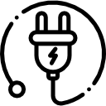
Problem | What are the key blockers in home electrification adoption?
Cost of Capital
Consumer Knowledge Gap
4:1 Contractor Expertise Ratio
“Home Electrification is expensive”
“Consumers are in the early innings of understanding their energy usage, incentives, and electrification technologies”
“Contractors are expected to be the experts”
Home Energy Consumption & Incentives
Electrical
Heat Pump
Gas Furnace
Mechanical
Finance
Electrification Technologies
Structural
Notes:
Home Electrification normally happens in phases, starting with solar.
Consumer cost saving story resonates in an high priced energy environment, but when stagnant, that story fades.
When people buy a home, they don’t expect the bank to know anything about electrical wiring. And they wouldn’t expect an electrician to explain the fine print of a mortgage loan. But when it comes to electrification upgrades, we expect installers to have all the answers—not just about the technology itself, but also the mechanical, electrical, structural, and even financial aspects of the project. And this gets me because most contractors core discipline is on average 2 out of the 4 at est. One could argue that contractors hire third party services or purchase software to help overcome the expertise hurdle. However, operational friction such as false expectations, inaccurate designs, poor system performance, etc. erodes the home electrification adoption journey.

Slide 10
04
Aurora’s Solution

Slide 11
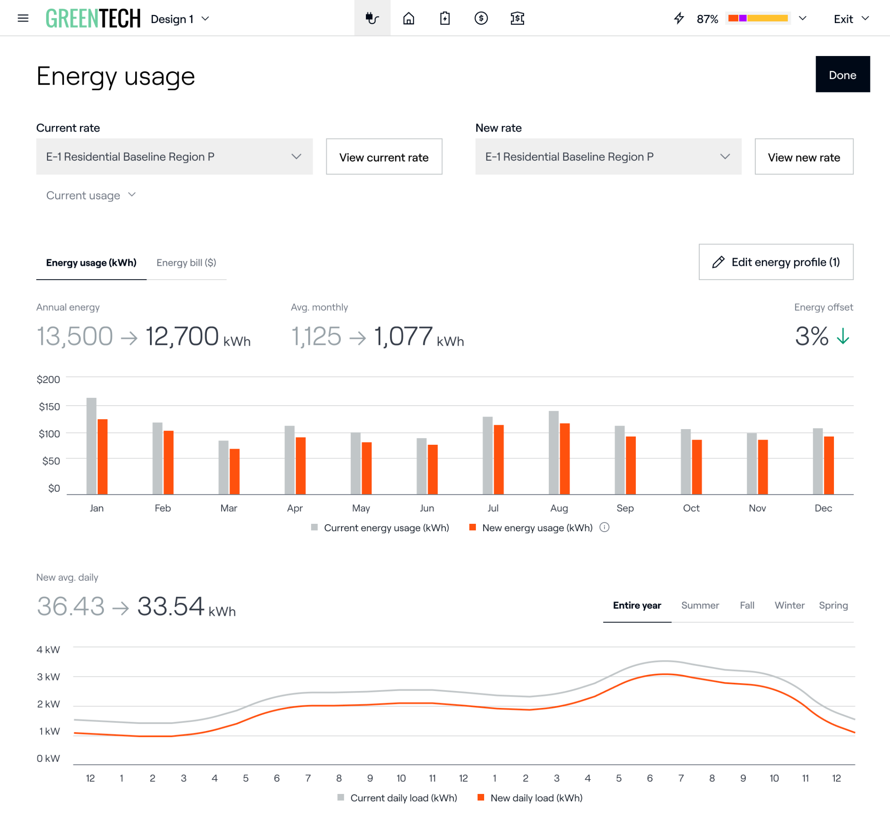
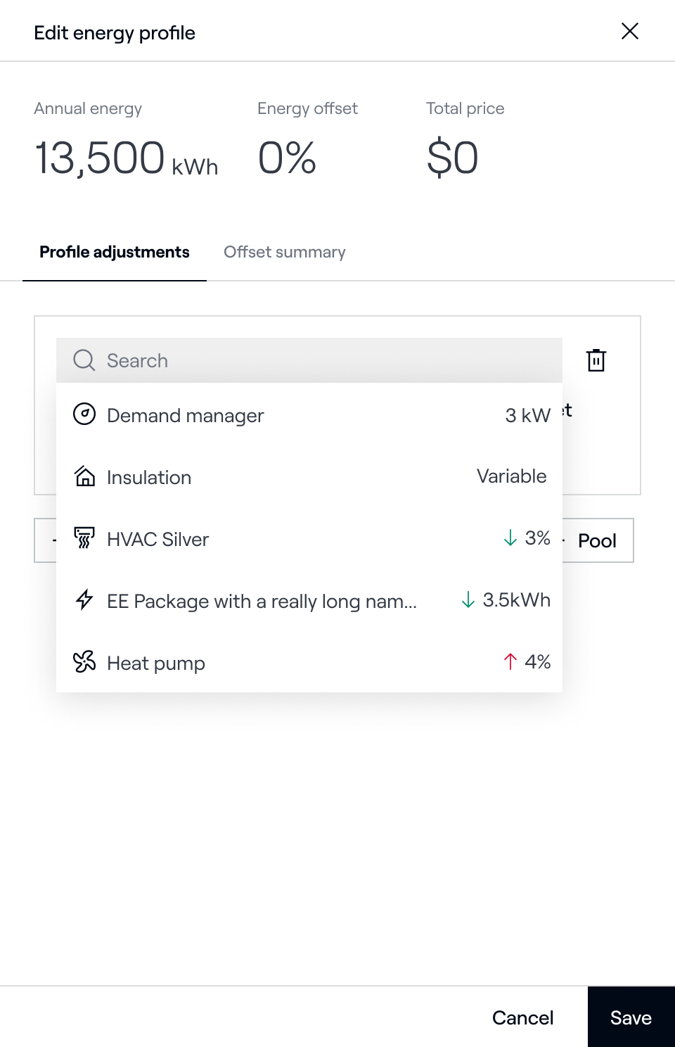
Aurora’s Solution | How is Aurora tackling these problems?
Energy Optimizations
Companies can configure custom “energy optimizations” with specific offset impacts for reps to incorporate into their homeowner proposals.
Build credibility by providing solar-plus-storage proposals for future holistic energy needs
Diversify your product portfolio to sell electrification and energy efficiency products, such as HVAC, heat pumps, and more

Slide 12
05
Predictions

Slide 13
Predictions | What will need be to true for mass adoption of home electrification technologies?
1
Utility Led Investments
While consumers desire some energy independence, they must also navigate their ongoing relationship with utilities. On-bill financing and innovative asset ownership models present compelling investment vehicles to address and fulfill these evolving consumer needs.
2
Policy & Utility Reform
Utilities still profit from selling more energy than incentivizing decentralized solutions. Changes in policy will shift utilities’ business models to generate similar (if not more) profit.
3
Declining Electrification Costs
The costs associated with electrification, including hardware and installation, remain elevated, posing a barrier to widespread consumer adoption. However, advancements in manufacturing processes, standardized installation practices, and streamlined permitting can significantly reduce these financial burdens, fostering greater accessibility and uptake.

Slide 14
06
Questions?

