Slide 1
Financial Performance and Innovative Financing Strategies in Zero-Emissions Transportation 2025 Wall Street Green Summit | Cornell Club, New York City
Kabir Nadkarni
EV Industry Assessment Specialist, CALSTART
March 18-19, 2025
CALSTART.org

Slide 2
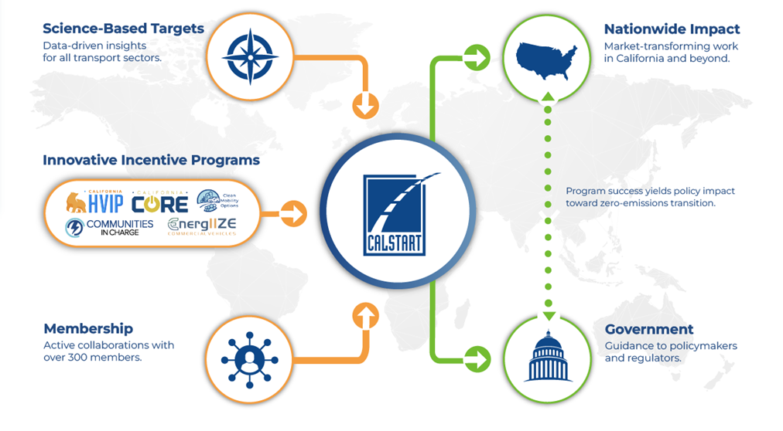
CALSTART’s Unique Value Proposition
Global Reach
International MOU
Notes:
Our internal, and unofficial, statement of strengths is that we:
Are driven by science-based targets to inform the ambition and urgency of large-scale action
Work closely with more than 300 member companies to get the industry perspective on current and desired market conditions
Occupy a leading role designing and administering market-leading programs in CA and elsewhere to accelerate markets and prime new ones
These inputs all influence how we operate and inform our policy advocacy as well as our work to implement transformative programs in markets in CA and beyond

Slide 3
CALSTART Works with 270+ Member Companies.
Together, We Accelerate the Clean Transportation Industry.
calstart.org

Slide 4
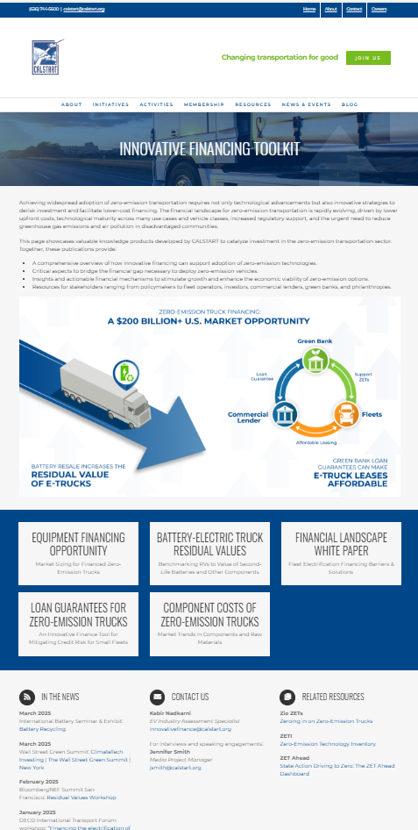
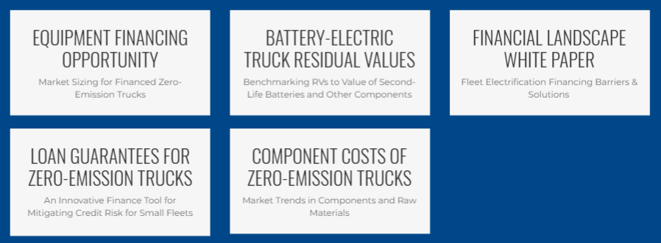
CALSTART’s Innovative Financing Toolkit A Resource Hub for Catalyzing Investments in Clean Transportation
A centralized hub for the financial community to learn about zero-emissions transportation, and for catalytic funders to access industry-vetted solutions for accelerating investments.
Media & Conference Coverage
October 2024: Canary Media: “Want to make EVs cheaper? Figure out what their used batteries are worth.”
February 2025: OECD International Transport Forum in Paris
February 2025: Bloomberg New Energy Finance Summit in San Francisco
March 2025: International Battery Seminar: Battery Recycling in Orlando
May 2025: D.C. Climate Week Urban Development and Mobility Panel in D.C.
www.calstart.org/innovative-financing
calstart.org/innovative-financing

Slide 5
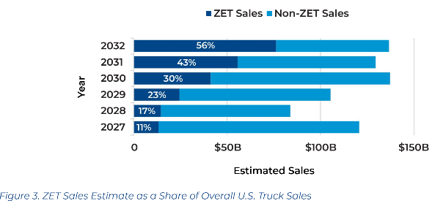
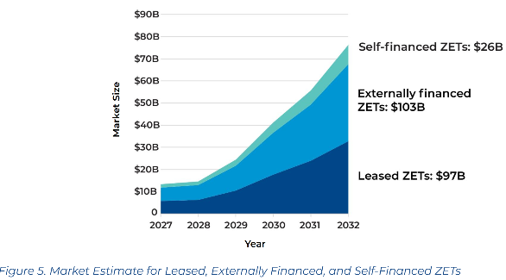
Study #1: Equipment Financing Opportunity in Zero-Emissions Trucks
Outreach material to educate equipment financing sector on the segment-specific market opportunities in zero-emission trucks stemming from ACT
https://calstart.org/zets-opportunity-in-equipment-financing/
calstart.org/innovative-financing

Slide 6
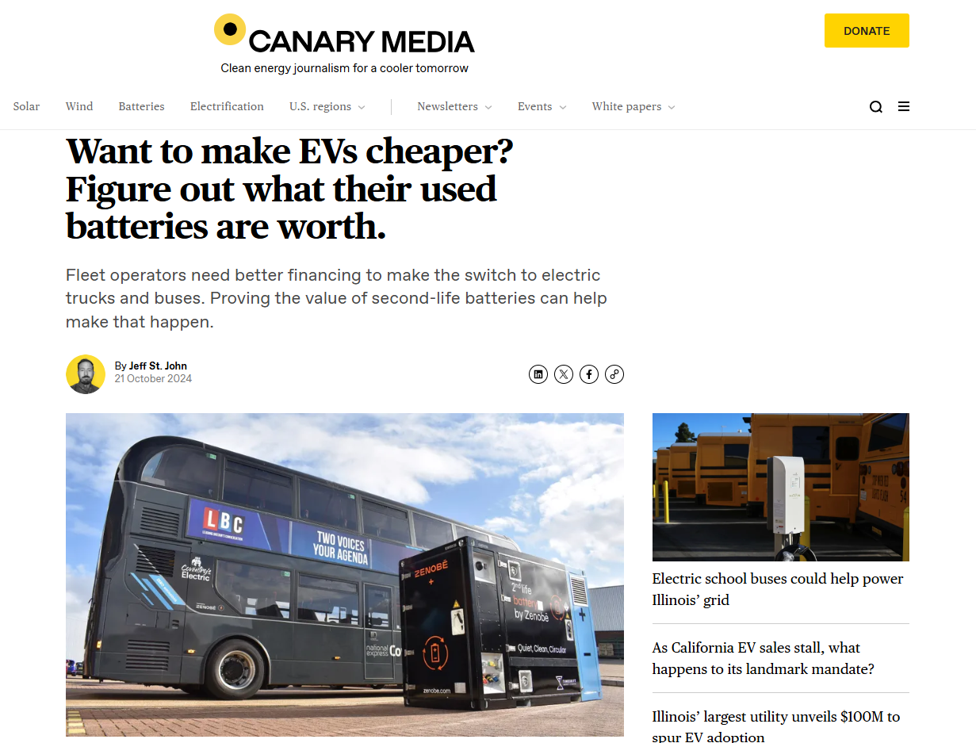
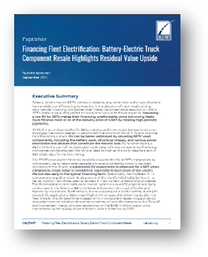
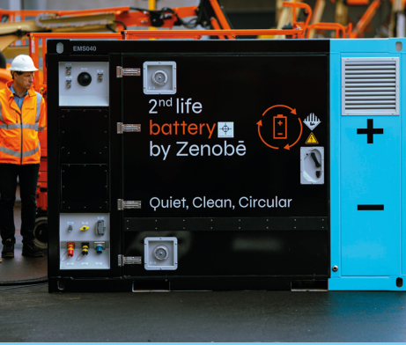
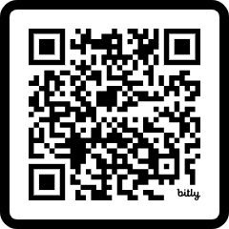
Study #2: Resale Valuation of Used Component Establishes a Competitive RV for Battery Electric Vehicles
Critical knowledge product on EV residual values highlights:
Method for benchmarking residual values to valuation of used components
Innovative companies who are repurposing second-life EV batteries
How this business model is improving affordability of EV leasing & financing
https://calstart.org/bet-component-residual-values/
calstart.org/innovative-financing

Slide 7
Study #2: Resale Valuation of Used Component Establishes a Competitive RV for Battery Electric Vehicles
Companies like Zenobe, Connected Energy, Tesla & Volvo have cited the EV battery’s long-term durability as market opportunity
Many companies are specializing in the second-life battery technology market
Second-life BE truck, bus and car battery supply could exceed 30 GWh by 2030 in the U.S., representing a $2.0-2.5B opportunity
Battery first life in EV
Battery second life in BESS
Battery third life in recycling
Typical battery degradation pattern for EV batteries from vehicles, to 2nd life stationary batteries, to 3rd life recycling

Slide 8
Study #2: Resale Valuation of Used Component Establishes a Competitive RV for Battery Electric Vehicles
When modeled for a typical electric yard tractor:
BE truck’s components together retain 15-25% RV of after a 5-year lease term
Estimate is much better than a the highly conservative outlook of 0% RV retention lenders currently use for BE trucks
Competitive with the 30% RV for 5-year diesel truck lease
Ongoing capacity for second-life application leads to higher BE truck RV after 8 years
calstart.org/innovative-financing

Slide 9
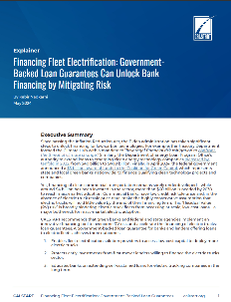
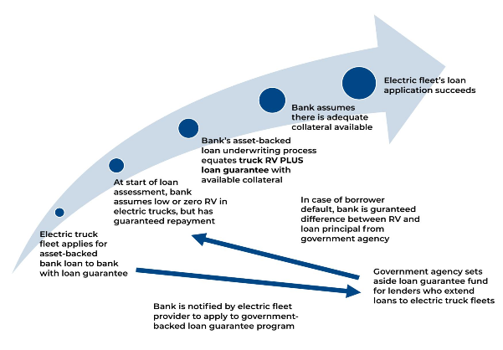
Study #3: Guidelines on How Clean Transportation Investors Can Benefit from Loan Loss Reserves
Upcoming Funding Opportunity in New York State: Loan Loss Reserve to Catalyze Clean Energy Financing in NYS Communities (PON 4378)
Due Date: 12/31/2025
Outreach material to educate lenders on how to take advantage of the California government’s Zero-Emission Truck Loan Loss Pilot
https://calstart.org/govt-loan-guarantees-for-electric-fleets/
calstart.org/innovative-financing

Slide 10
Thank you.
Accelerate investments in zero-emissions transportation using CALSTART’s Innovative Financing Toolkit:
www.calstart.org/innovative-financing/
Kabir Nadkarni
EV Industry Assessment Specialist
knadkarni@calstart.org
We change transportation for good.
CALSTART.org

