Slide 1
New Ideas in Energy Storage
Wall Street Green Summit
March 19, 2025
Douglas Sherman

Slide 2
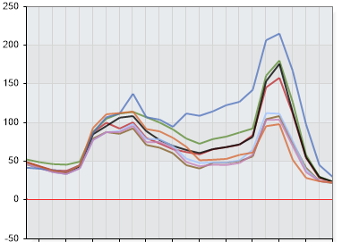
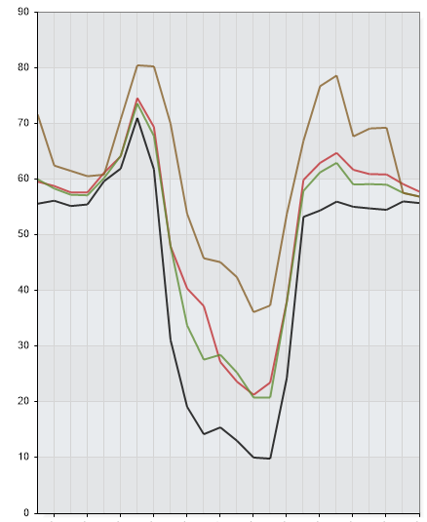
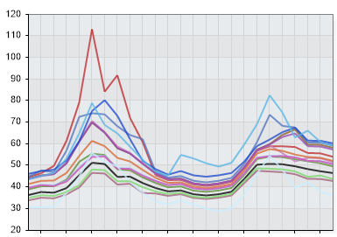
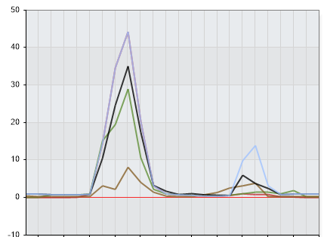
Introduction
The Smart Cow Problem
From Wikipedia: The smart cow problem is the idea that a technically difficult task may only need to be solved once, by one person, for less technically proficient group members to accomplish the task using an easily repeatable method.
“The term is derived from the expression: "It only takes one smart cow to open the latch of the gate, and then all the other cows follow”
BESS Energy Arbitrage
BESS Profits: Generate revenue arbitraging intra-day price differences
BESS Opportunities: Real-time energy, Day-Ahead Energy and Ancillary Services
The Objective: Be the cow finding the latch and opening the gate the widest (=PROFITS) and for the longest possible time before others follow
The Process:
Understand grid behavior
Understand the weather and demand
ERCOT DA
CAISO DA
NYISO DA
ERCOT Ancillaries

Slide 3
Energy Storage and the Marketplace
Energy Storage
Capture of energy at one time for use at a later time
Frequency response
Time shifting
Philosophy
Renewables create intermittency (wind/solar shortfall)
Intermittency creates volatility (expressed via price movements)
Batteries are a call option on volatility i.e. long volatility trade
Why Now??
Batteries (as a flexible reliable resource) complement the variability created by renewable resources (an inflexible resource). Formerly, this market was served by gas peakers (10- minute response time vs. batteries with relatively instantaneous response time.
The Marketplace
ISO functions to match supply with demand not vice versa:
Grid is oriented to be oversupplied
Grid functions with a robust day-ahead marketplace
Allows for entities to “speculate” in the marketplace (DART spreads)
BESS asset flexibility allows for bidding into the DA and RT markets to exploit short-term events
New grid paradigms to deal with: a) Negative pricing; and b) curtailments
Factors impacting grid operations to allow for real time price deviations:
Oversupply
Transmission capacity issues
Thermal imbalances (less ramping downward)
Weather events (impact on both supply and demand)

Slide 4
What creates market volatility and what impacts BESS profits
Gas Price Levels
Thermal Generation (Peakers and Heat Rates)
-Unplanned Outages & Unit Trips
Duration/SOC
Extreme Weather
Macro Demand (Demand>Supply)
Regulatory Policies

Slide 5
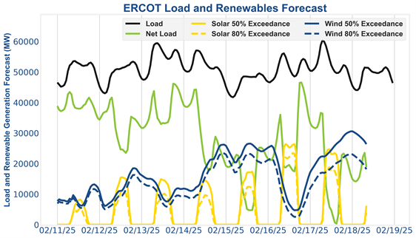
ERCOT Overview
ERCOT Energy Storage Revenues
As an energy-only marketplace, ERCOT is (i) the most lucrative, (ii) the most liquid, and (iii) the largest energy-only ISO
Except for assets that have executed a bilateral arrangement, all BESS owners must face ERCOT as a counterparty and need to be able to trade via a Qualified Scheduling Entities (“QSEs”)
There are two main markets within ERCOT:
Ancillary Services Market
Day-Ahead (“DA”) & Real Time (“RT”) Energy Markets
Trading Ancillaries involves balancing between five products:
Responsive Reserve Service (“RRS”)
ERCOT Contingency Reserve Service (“ECRS”)
Regulation Up (“Reg Up”)
Regulation Down (“Reg Down”)
Non-Spin Reserve Service (“Non-Spin”)
Trading DA / RT in ERCOT
Charging Hours | Why? | Discharging Hours | Why? | Optimal Outcome
H00-H06 | High wind production in ERCOT West depresses prices | H08-H09 | Morning Ramp | Seek RT spikes & understand dynamics that influence such spikes
H12-H15 | Solar generation creates the belly of the “Duck Curve” | H17-H19 | Evening Ramp

Slide 6
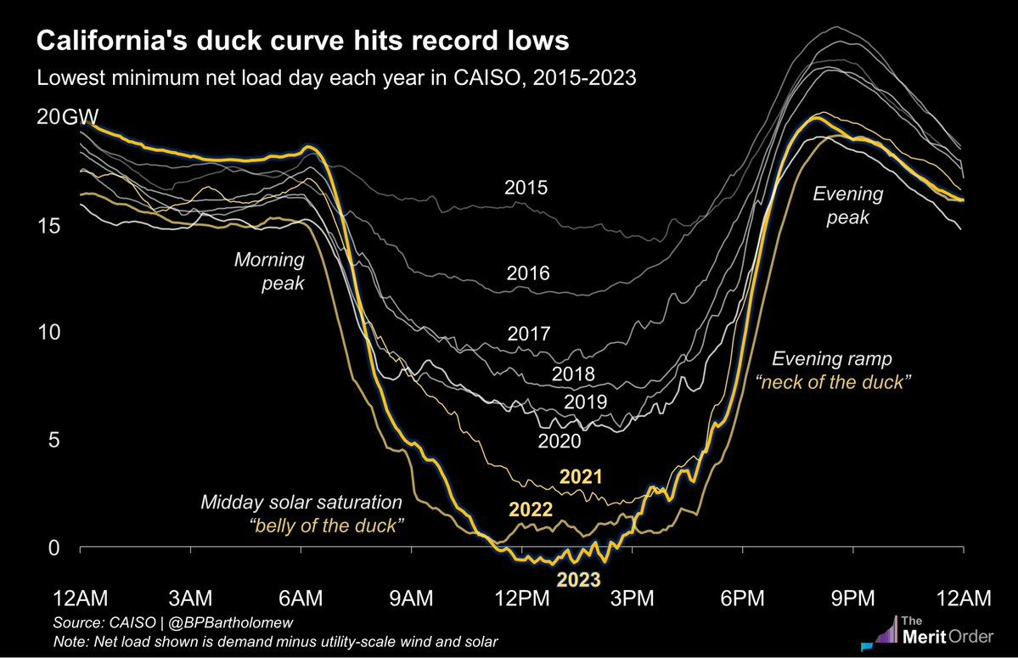
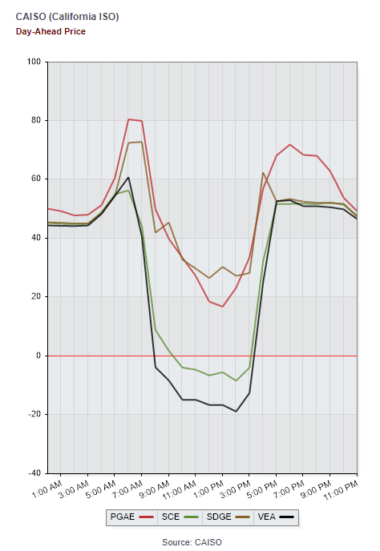
CAISO Overview
CAISO Energy Storage Revenues⁽¹⁾
CAISO is similar to ERCOT as an energy-only market, with the one exception being the Resource Adequacy (“RA”) market
RA is a mandatory planning and procurement process to ensure CAISO has adequate resources to serve all customers in real-time
The program requires that Load Serving Entities (“LSEs”) meet a Planning Reserve Margin for their obligations
Practically speaking, RA behaves like a capacity payment in that it provides for around-the-clock revenues with a creditworthy counterparty
There are three types of RA available: System, Local and Flex
Ancillary prices are more subdued than ERCOT due to the subsidy provided by RA revenues
The ISO exhibits a green / renewable focus that exerts pressure on thermal generation
90+% of new Interconnection applications are for hybrid (solar / storage) installations
Solar generation sees more curtailment in CAISO
This leads to a more severe “Duck Curve” in CAISO, commonly referred to as the “Canyon Curve”
Source: CAISO, @BPBartholomew.

Slide 7
NYISO Overview
NYISO Energy Storage Revenues
The Value of Distributed Energy Resources tariff (“VDER”) is the most benevolent revenue paradigm for BESS assets in NYISO
BESS facilities enrolled in the VDER tariff have a cap of 5 MW of capacity
All BESS assets with less than 5 MW of nameplate capacity are automatically enrolled into the VDER tariff
VDER assets are compensated by a mix of capacity, Demand Reduction Value (“DRV”) and energy arbitrage revenue streams
The VDER tariff provides BESS assets a specific “charging window,” a window of time during which you can charge every day
VDER assets are not allowed to charge outside of those times without incurring punitive
This limits the flexibility of BESS operators pursing energy arbitrage revenue in NYISO compared to ERCOT
VDER:
DRV + ICAP + DA

Slide 8
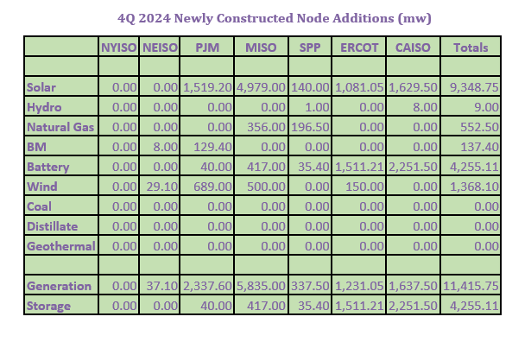
Conclusions
Growth
Energy Storage
Future
BESS is becoming integral part of the grid and will take on evolving roles within each ISO.
Regulatory parties will be adapting new rules/tariffs
Development and the interconnect process will be refined over time
Contractual relationships i.e. tolls/PPA may become more prevalent to mitigate price risk
Trading and arbitrage opportunities will evolve as markets change and/or become saturated in certain nodes.

