Slide 1

Peter Fusaro
2025 Wall Street Green Summit
March 18, 2025
What can we do about plastics?
Trent Romer
Sustainability Operating Partner
LongueVue Capital

Slide 2

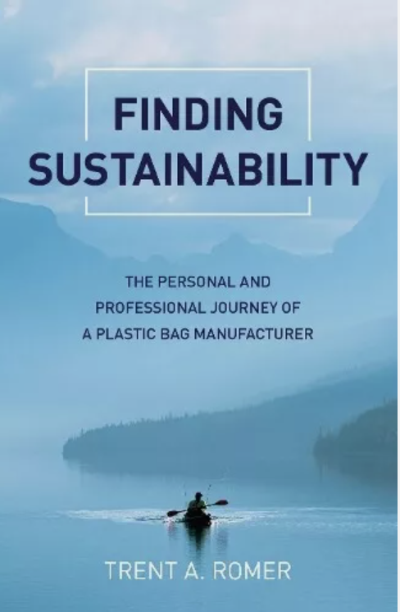
What if…
Family Business
Journey to Change
Writing Story

Slide 3
What did we do?
3 new materials brought to market (biobased, PCR, compostable)
Internal waste reduction of 25%
Participation in Riverkeeper
New company vision (planet, people, company)
Employee trainings
Joined the Sustainable Packaging Coalition
Formation of sustainability committee
New website sustainability page linked off page homepage
Created new marketing materials
Email blasts
Blogs & podcasts
RESULTS: Re-energized employees, increased sales (by 8% related to new materials and program), increased profits (waste reduction added $300k to bottom line), stayed ahead of regulation to come and attracted investment.
We sold the business in 2021. (2X)

Slide 4


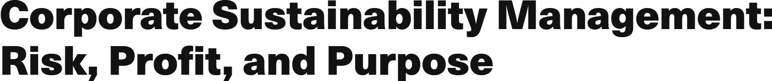
Hired as a sustainability operating partner
One BIG problem
All have sustainability issues to address.
The goal was to develop a process to figure out what those are.
Back to School
Start with WHY
then address HOW to do it
and the WHAT to do falls out.
*Start with WHAT? Often fails to connect with employees & customers to convey an authentic program that inspires, limits risk, unveils opportunity and drives value.

Slide 5
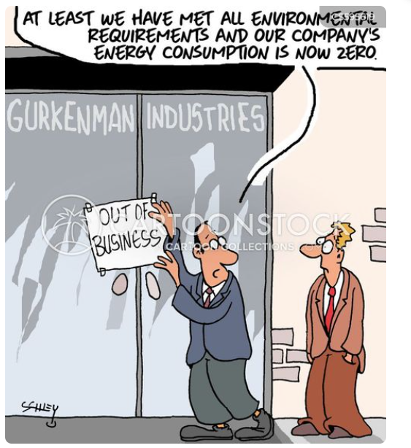
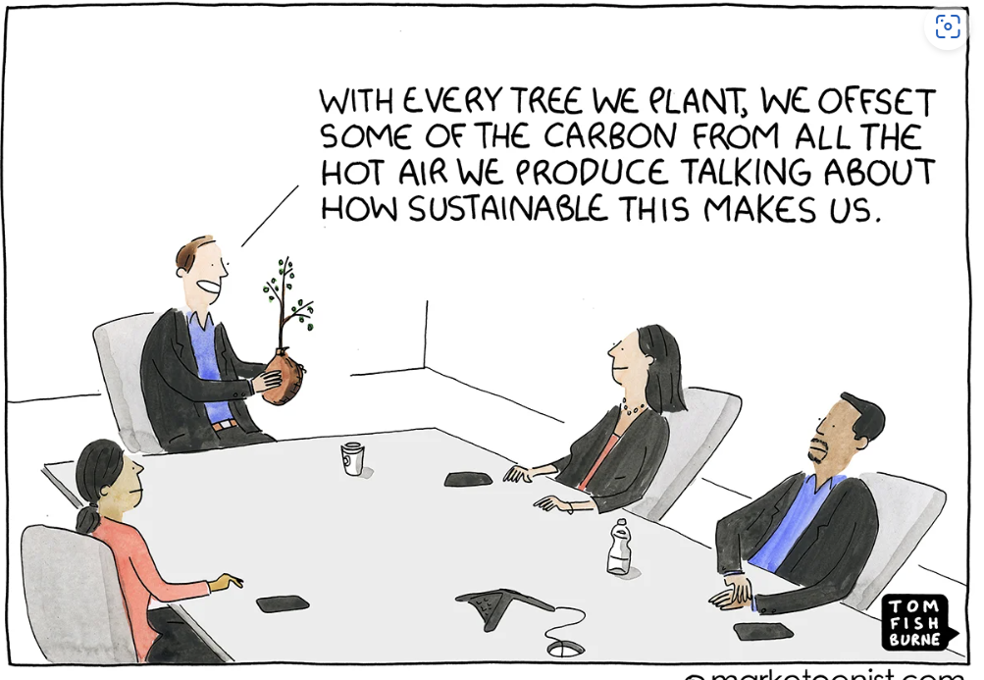
versus
Too Much
Too Little
Goal: Find the middle ground through 4 step process

Slide 6
Step 1: Stakeholders (the Why)
Do your employees want better benefits, training, safety measures, culture and fair pay?
Are your customers asking for more sustainable product and service options? Do they want to do business with companies that share their values?
Are your investors looking to reduce risk in their business investments?
Does your community want an organization to give back to it?
Are your customers downstream beginning to reach upstream for documentation of authentic sustainability action in their supply chains?
Is regulation a threat to future business?
Does public sentiment about your product, service or role in the community positive or negative?
Are Non-Governmental Organizations speaking out about your industry?
In general, sustainability offers a framework to address these questions and create the business case for sustainability.
Sustainability within Your Organization
Employees
Customers
Investors
Communities
Supply Chain Members
Regulatory Agencies
Social Sentiment
NGO’s

Slide 7
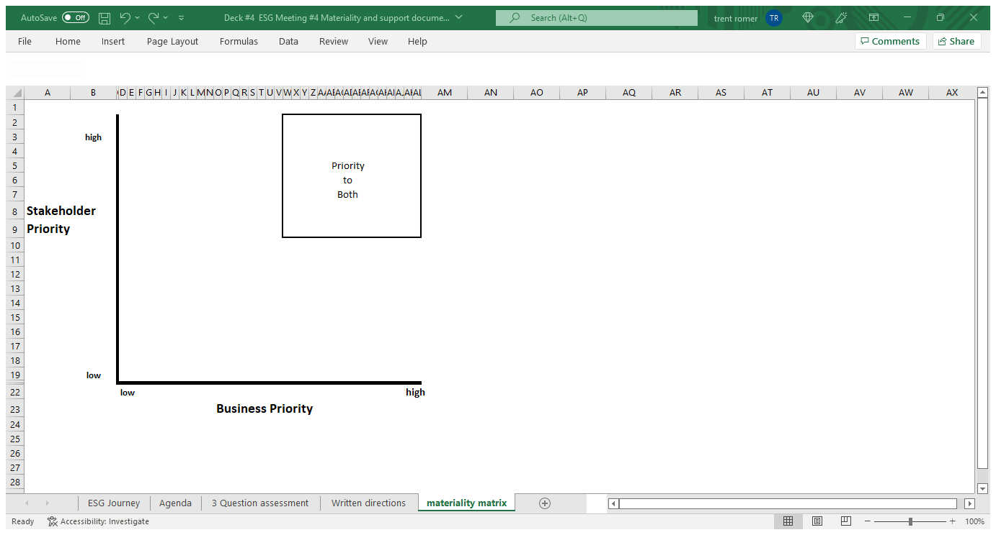
Step 2: Materiality

Slide 8
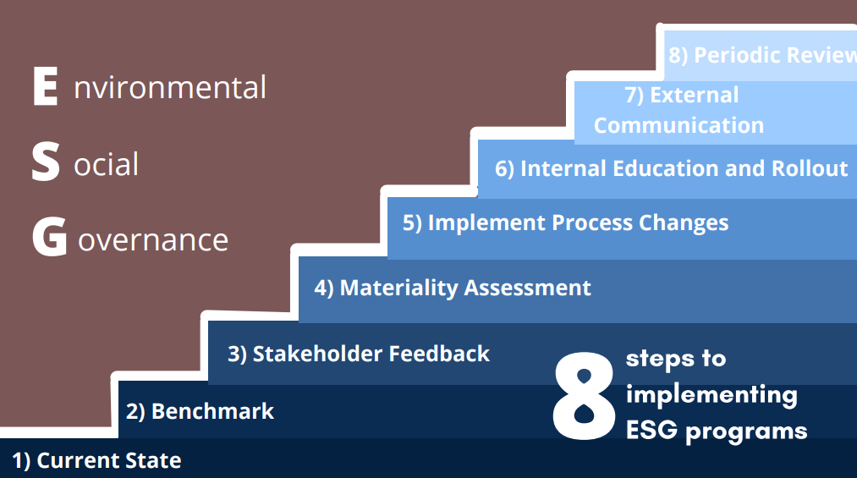
Step 3 Authentic Actions (innovate) & Step 4 Communicate
4 Steps in more detail:

Slide 9
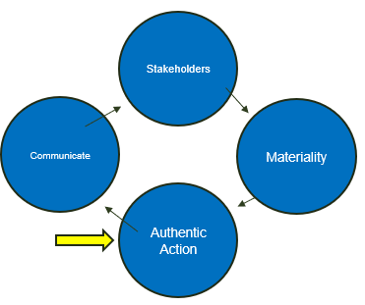
So what do we do about plastics today?
The same thing we do with any sustainability issue.
4 Basic Steps
Determine issues important to stakeholders
Prioritize stakeholder issues using materiality
Take authentic action to address priority issues
Communicate the action back to stakeholders
Circular Flow
Application of each step is uniquely determined by each situation & each company.
Do a few things well (not multiple poorly).

Slide 10
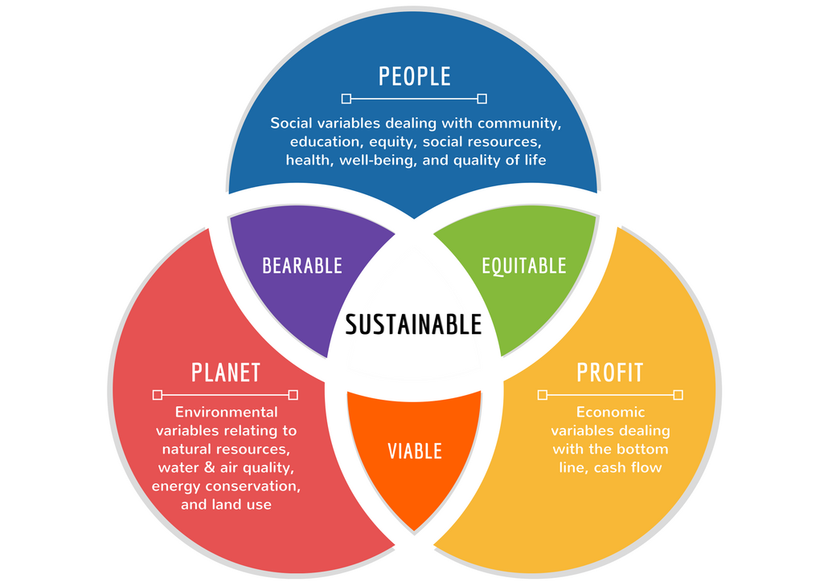
Priority Issues are ESG +F
S
E
G
“ESG + F”

Slide 11
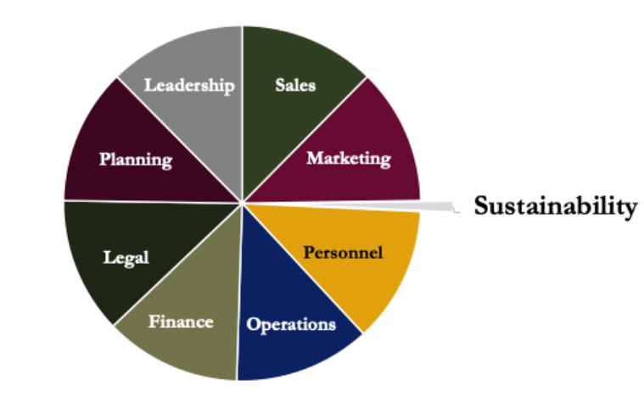
sustainability
versus

Slide 12

I don’t know the opinions of the people I engage with.
I try to strip out opinion by….
Stakeholder View
and
50, 50, 100 appeal

Slide 13

One for the road
Moonshots & Slingshots: Business Case for Sustainability
Trent Romer & Lisa Foster
TEDxBoston
(youtube.com)

Slide 14
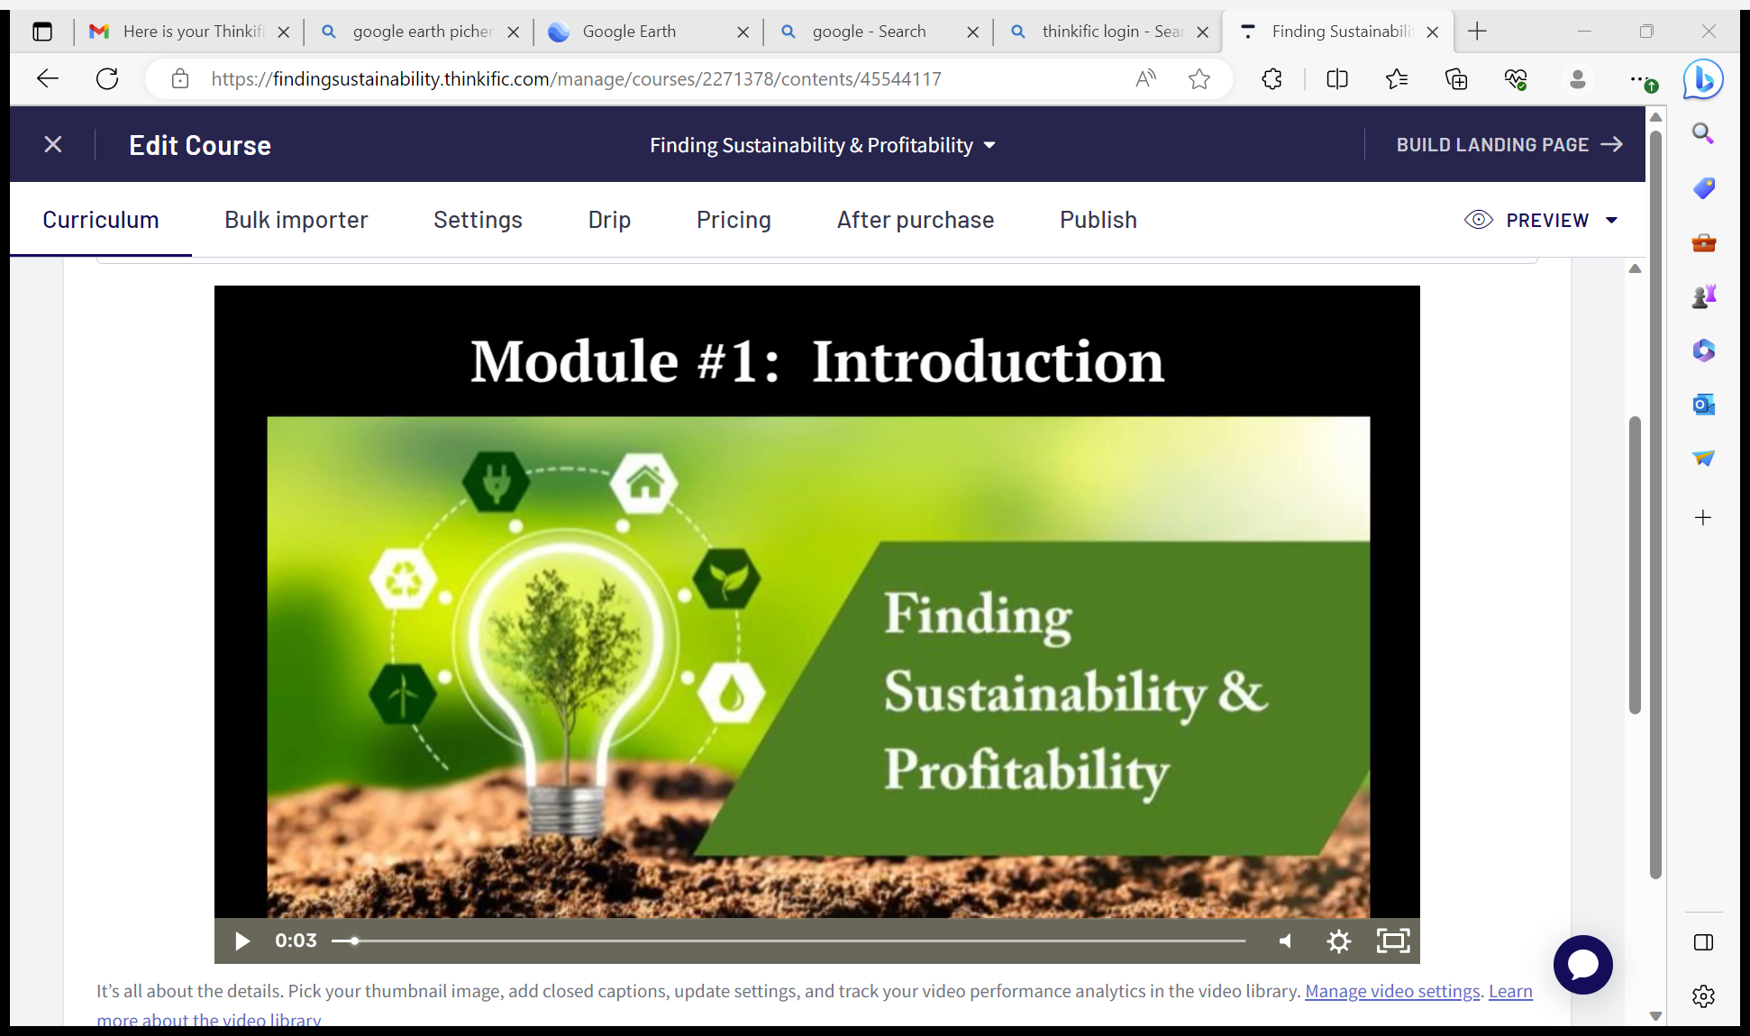

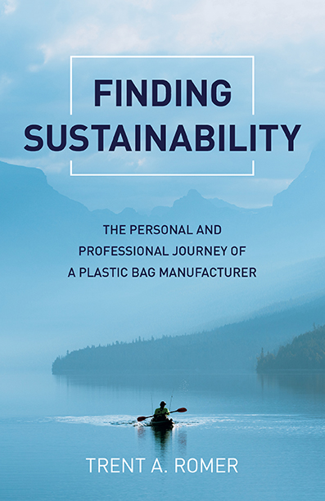
Thank you!
More information on my work and events can be found at www.trentromer.com. Thank you for your time and interest!
Online course
Book
Book

