Slide 1
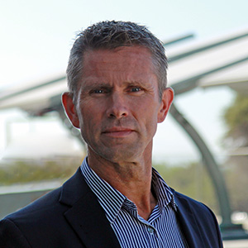
Beam Global – 2025 Wall Street Green Summit
Presented By Desmond Wheatley
Beam Global CEO and Chairman of the Board

Slide 2
Forward Looking Statements Disclaimer
While we have taken steps to present accurate information, there may be changes in circumstances or assumptions not captured since its composition. Except for historical information presented in this slide show, any forward-looking statements involve risks and uncertainties. Forward-looking statements may be identified by the use of forward-looking terminology such as “may,” “can,” “will,” “could,” “should,” “project,” “expect,” “plan,” “predict,” “believe,” “estimate,” “aim,” “anticipate,” “intend,” “continue,” “potential,” “opportunity” or similar terms, variations of those terms or the negative of those terms or other variations of those terms or comparable words or expressions.
These forward-looking statements are based on our current expectations, estimates and assumptions and are subject to certain risks and uncertainties that could cause actual results to differ materially from our current expectations, estimates and assumptions and such statements. We caution the reader or viewer that there can be no assurance that actual results or business conditions will not differ materially from those projected or suggested in such forward-looking statements as a result of various factors, including, but not limited to, the risk factors discussed in the filings that Beam Global makes with the Securities and Exchange Commission, which you are urged to review for more information.
We expressly disclaim any obligation or undertaking to release publicly any updates or revisions to any forward-looking statements contained herein to reflect any change in our expectations with regard thereto or any change in events, conditions, or circumstances on which any such statements are based. The information presented does not present all information which a reader might consider material and is not an offer to sell or solicitation of an offer to buy any securities of Beam Global.
Any offer and any representations relating to such offer will only be contained in final executed documents relating thereto. Unless specifically incorporated into such documents, this presentation and the information contained herein is not made a part thereof.
NASDAQ: BEEM

Slide 3
Agenda
Company Snapshot
The Trump Effect
The Rest of the World’s Response
Are We Ready for Electrification?
Is the Era of Electric Vehicles Over?
What’s Beam Global Doing About This?

Slide 4
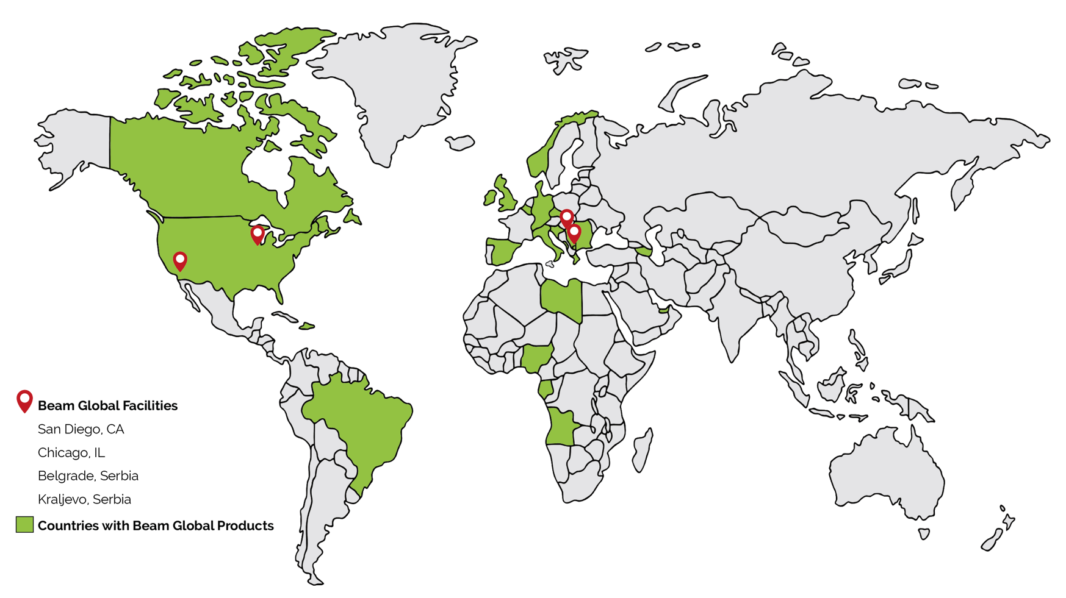
Company Snapshot
Sustainable technology innovation company.
277 employees globally, headquartered in San Diego, CA with operations in Chicago, IL, Belgrade and Kraljevo, Serbia.
Made-in-America, patented products for the electrification of transportation, energy resiliency and Smart Cities infrastructure.
Fastest deployed, most scalable, lowest TCO, most robust EV charging infrastructure products.
Beam is publicly traded on Nasdaq under the ticker BEEM. No debt. $100M line of credit untapped.

Slide 5
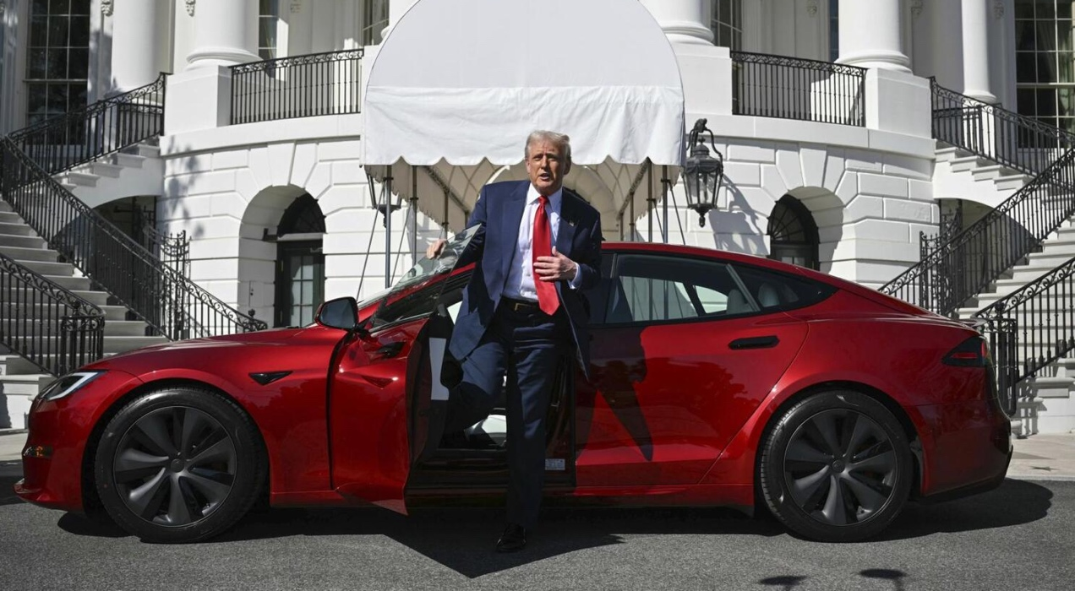
The New Administration
President Trump said he is eliminating the “electric vehicle (EV) mandate.”
What he has requested:
To eliminate $7,500 tax credit for buyers of EVs.
To eliminate federal support for EV Charging stations.
To eliminate low interest loans for traditional automakers building new plants to manufacture EVs.
To eliminate local regulations in California and 17 other states that follow California’s regulations which plan to ban the sale of gasoline-powered vehicles by 2035.
To decommission already paid for government-owned EV chargers and EVs.
A brand-new Tesla…

Slide 6
The Rest of The World’s Response
Europe
The EU targets 80% of new car sales to be electric by 2030 and 100% by 2035, in the world’s largest automotive market with over 400 million automobiles.
Africa
Ethiopia is the first country to ban the import of both new and used internal combustion engine vehicles.
The Middle East
Petrodollar investments fuel significant renewable energy and electrification goals, accelerating EV adoption.
China
China dominates the EV market with 69% of global sales in 2024 - 40% year-on-year growth.
Beam Global’s Response
Expanding to Europe, Africa, and the Middle East to meet rising EV demand with off-grid, solar-powered charging solutions.

Slide 7
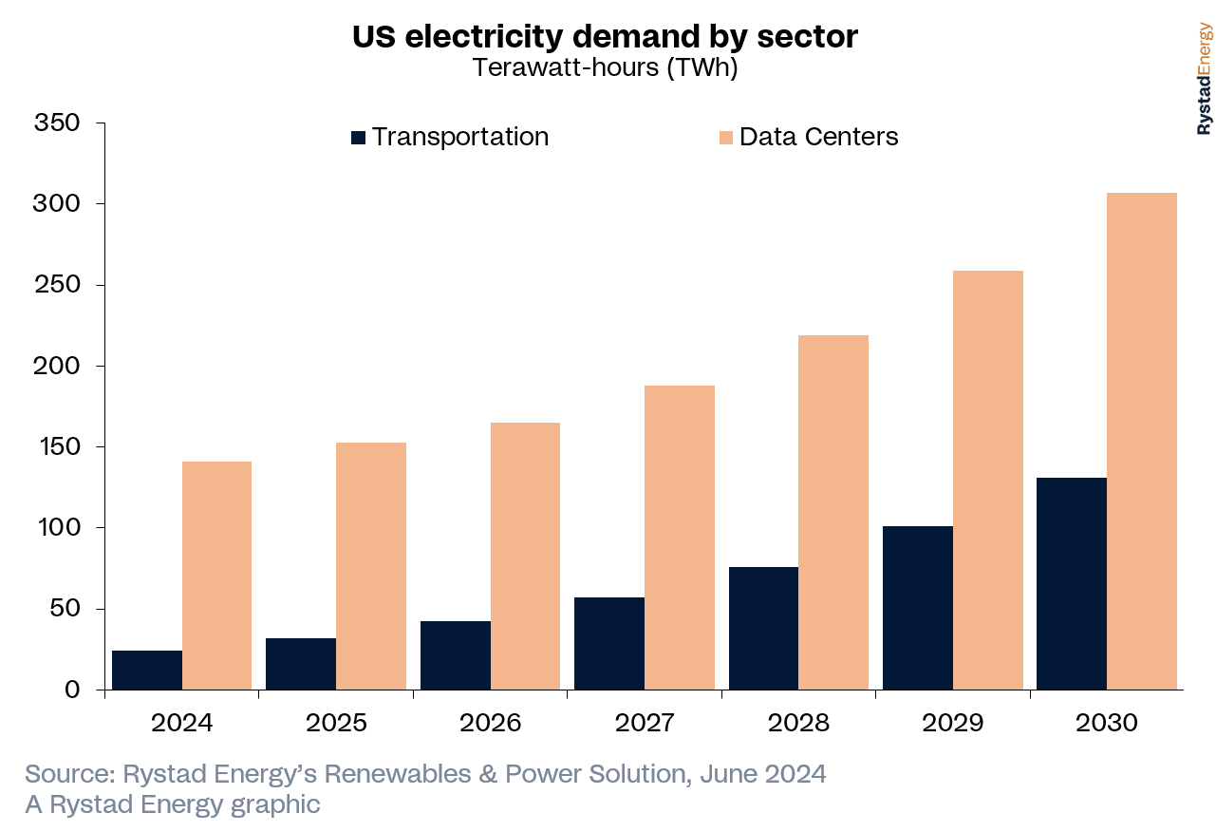
U.S. Electricity Demand: A Surge Driven by Data Centers & More
U.S. electricity demand is surging, driven by data centers, AI, and electrification of industry and transportation.
Data centers’ demand expected to triple by 2028.
Combined data centers and EVs projected to add 290 TWh of demand by 2030 - equivalent to Turkey’s total electricity demand.
Beam believes it will be much more dramatic.
Source: https://www.energy.gov/articles/doe-releases-new-report-evaluating-increase-electricity-demand-data-centers
Source: https://www.rystadenergy.com/news/data-and-ev-create-300-twh-increase-us

Slide 8
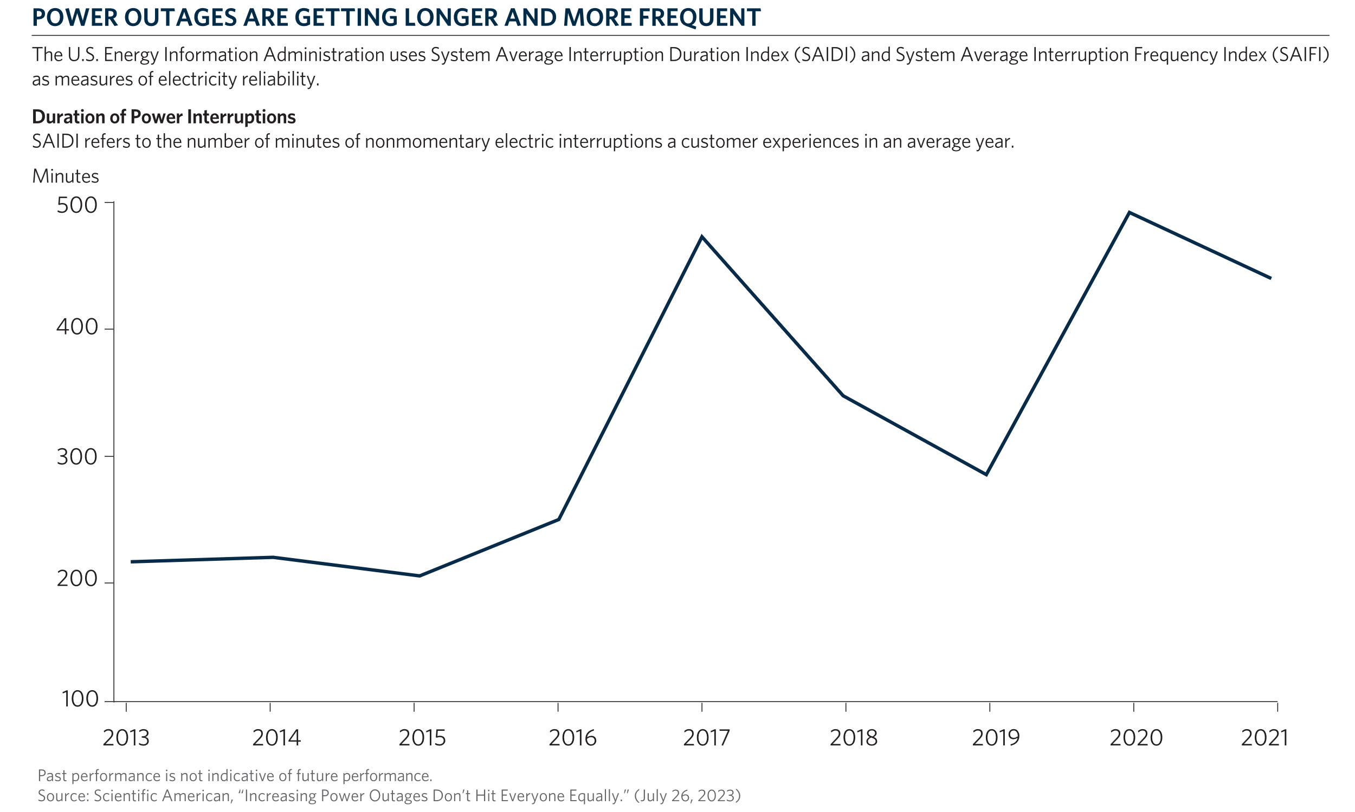
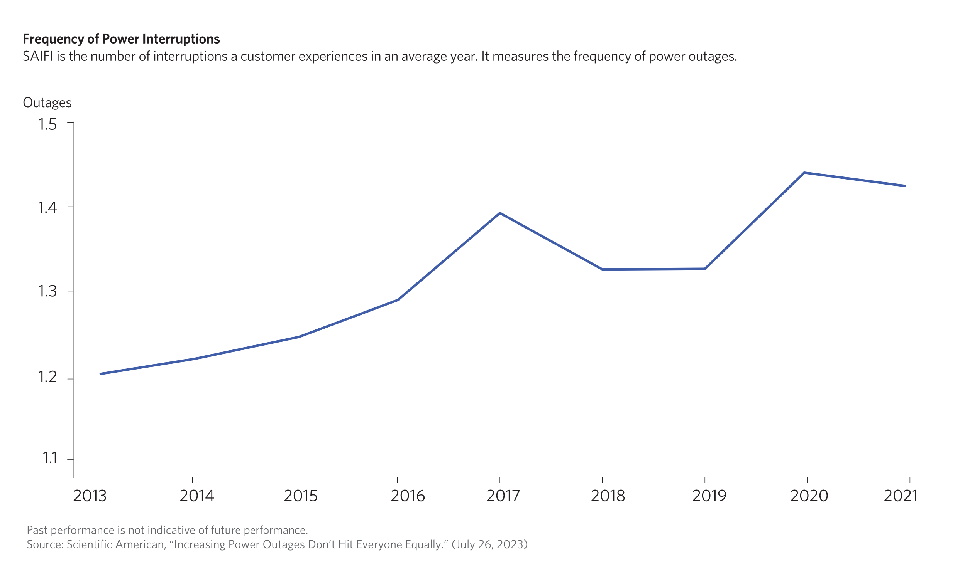
U.S. Power Outages
The U.S. transmission system will need to at least double in size by 2050 to keep up with demand.
Power outages cost billions of dollars annually and are very dangerous.
Major power outages increased by 64% in the decade from 2011 compared to the decade from 2000, a trend expected to worsen as demand rises.
Hurricane Helene made landfall on Sept. 26th, 2024, in Florida and caused over 4.7 million power outages across Southeast US.
Source: https://www.forbes.com/sites/francescadominici/2025/02/16/the-dilemma-between-a-strained-power-grid-and--sustainable-ai/
Source https://www.spglobal.com/commodity-insights/en/news-research/latest-news/electric-power/092724-hurricane-helene-causes-over-47-million-power-outages-across-southeast-us

Slide 9
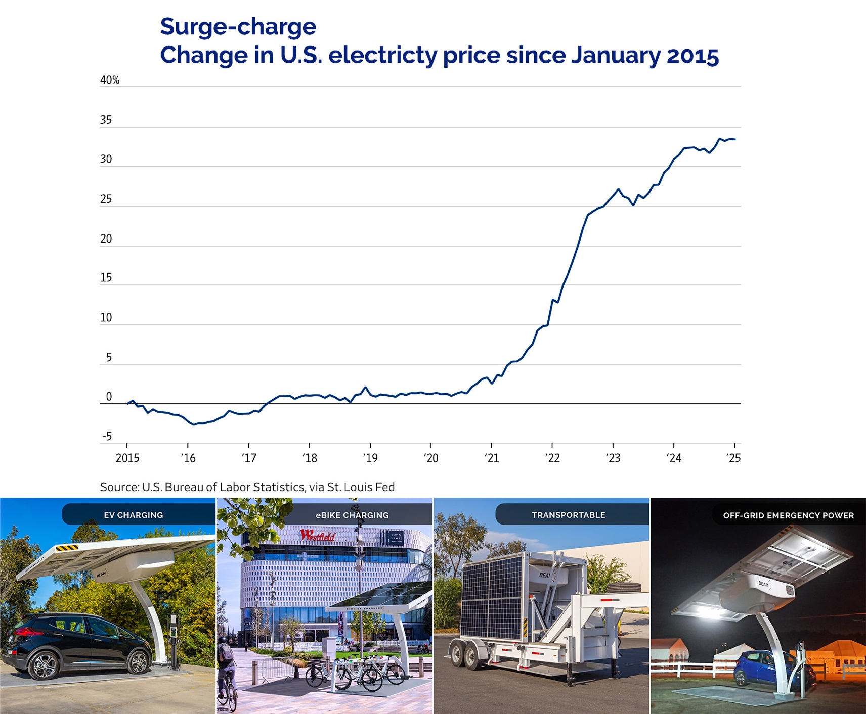
And The Costs Keep Going Up…
U.S. electricity prices have surged approx. 35% since 2021

Slide 10
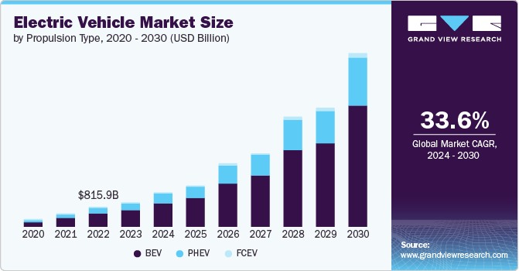
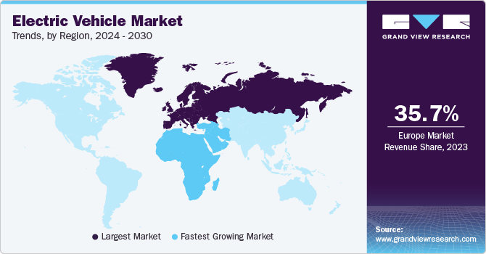
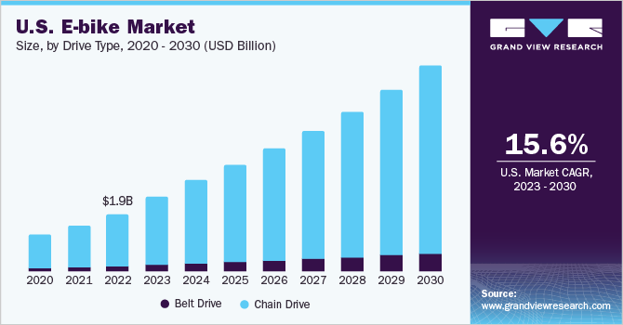
Is the Era of EVs Over?
Global EV sales increased by 18% in January 2025 *
* Source: https://www.reuters.com/business/autos-transportation/global-electric-vehicle-sales-up-18-january-2025-02-12/
10

Slide 11
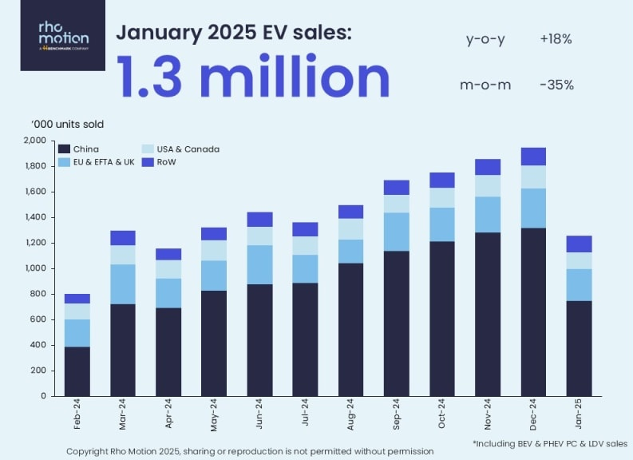
Global EV Sales – January 2025
The US and Canada EV market experienced a 22% year-over-year increase, reaching 0.13 million units sold.
The European EV market experienced a 21% year-over-year increase, with over 0.25 million units sold.

Slide 12
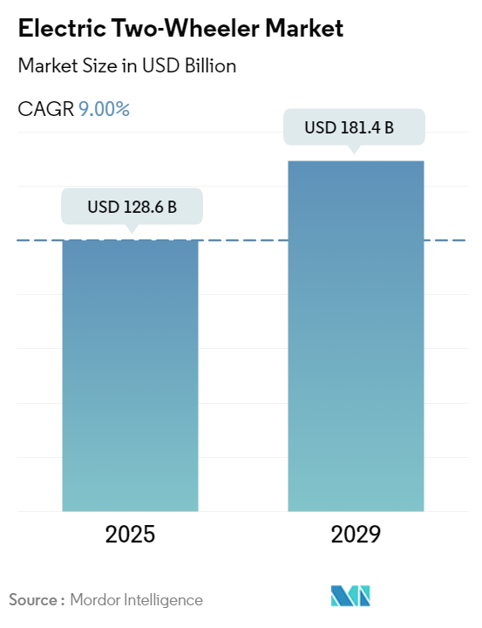
Growth of EVs on Two Wheels
United States market:
Growing at a CAGR of 11.36% during the forecast period 2024-2031.
Rising from USD 3.91 billion in 2023 to USD 9.25 billion in 2031.
European Market:
Growing at a CAGR of 15.02% during the forecast period 2025-2029.
8.73 Billion USD in 2025 and is expected to reach 15.28 billion USD by 2029.
Source https://www.marketsandata.com/industry-reports/united-states-electric-two-wheeler-market

Slide 13
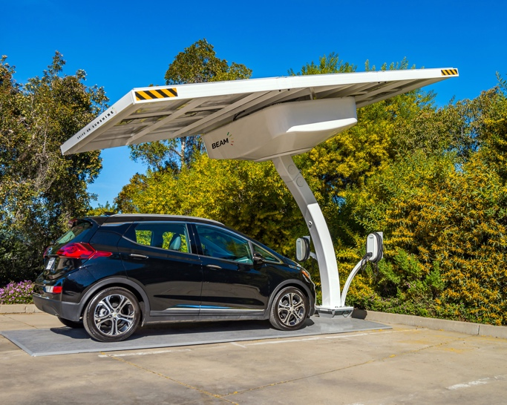
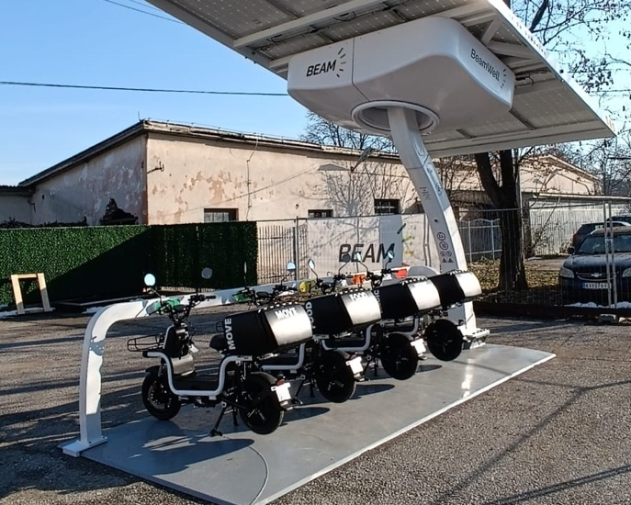
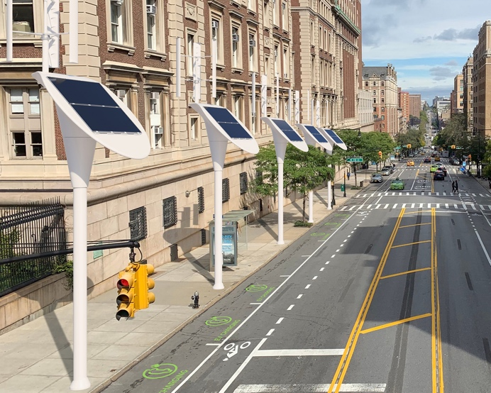
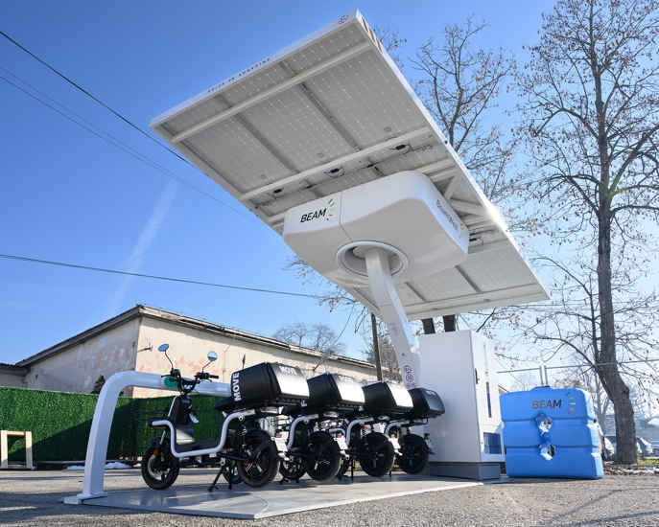
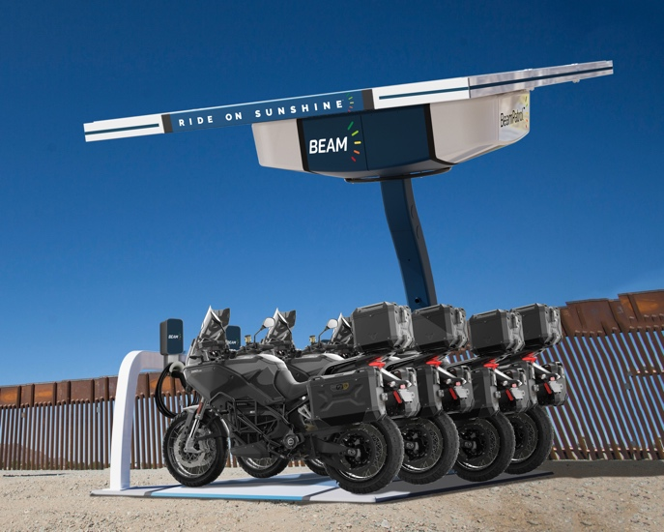
What’s Beam Global Doing About This?

Slide 14
Beam Global Disaster Preparedness
Off-Grid Emergency Power
Charge during blackouts, utility outages, weather events
Ideal for high-risk locations
Wind-rated up to 160 mph
Flood-proof up to 9.5 feet
Essential asset during emergencies
Constantly renewed source of reliable electricity
Beam Global EV ARC™ systems continue to provide essential power during hurricane Helene
Beam global EV ARC™ systems continue to provide essential power during hurricane Helene

Slide 15
Our Flagship Product- The EV ARC™
World’s only transportable, off-grid, solar-powered EV charging solution. Over 1,700 built and deployed, globally, since 2019.
Patented
Durable and rated to withstand flooding and extreme weather
Rapid and scalable deployments
No permitting required
No construction required
No electrical work required
No grid connection required
No vulnerability to blackouts
GRID-TIED CHARGING DEPLOYMENT TIME 18-24 MONTHS
BEAM OFF-GRID CHARGING DEPLOYMENT TIME 1 HOUR

Slide 16
BeamBike™
Solar-Powered eBike Charging station deployed in minutes.
Secure location to park, lock and charge 12 eBikes
No Construction, No electrical connection
Onboard battery storage
No utility bills
Transportable so can be relocated as eBike charging patterns emerge and change

Slide 17
BeamPatrol™
Law enforcement eMotorcycle patrol station for safety and security.
Available bundles with or without eMotorcycles
Fast, quiet stealth patrols
No construction, no electrical work
Charge during grid outages
Clean reliable renewable energy
Onboard energy storage
Rapid deployment
No utility costs
Product Renderings

Slide 18
BeamSkoot™
Park, lock and charge up to 4 eMobility scooters.
Available bundled with or without eMopeds
No construction, No electrical work
Rapid deployment
Transportable so can be relocated if needed
Charge with clean renewable energy
Highly visible sustainability initiative
Ideal for campuses, parking enforcement, rentals, resorts, and anywhere reliable scooters are required

Slide 19
BeamSpot™
Streetlight replacement uses existing grid connection, solar and light wind generator.
Patented
Curbside charging
No heavy construction
No electrical upgrade
Proprietary energy storage
Networked and sun tracking
No vulnerability to blackouts

Slide 20
BeamWell™
Life-sustaining access to clean water, electricity and eMobility for emergency relief in crisis zones.
Off-Grid Solar Desalination
4 delivery eMopeds for water and food distribution
500 liter water tank
Self-contained operational system
Container Transportable
Rapidly deployed

Slide 21
Contact Beam
Learn more about Beam Global’s
EV charging, energy storage, energy security and outdoor media.
Call: +1-858-799-4583 Email: BeamTeam@BeamForAll.com Visit: BeamForAll.com
Thank You
For Listening!
21

