Slide 1
Decarbonizing the Built Environment: Investment Opportunity and Marketing Potential
John Oppermann

Slide 2
Existing Inventory and Growing Demand for Green Homes
Building and construction is nearly 40 percent of global carbon emissions
Regulatory carrots and sticks
Climate pressures
Includes: energy efficiency, electrification, low-carbon building materials, and renewable energy
John Oppermann

Slide 3
Limits of Current Marketing and Communication
Limited knowledge of what a green building is
Overemphasis on technical details and jargon
Lack of specificity on benefits to end users
Reluctance to emphasize sustainability features
John Oppermann

Slide 4
Sustainable Food Industry as a Guide
John Oppermann
Sustainability goes mainstream
Shift from inferior to premium
Tied to wellness and elevated lifestyle
Popularized by high-profile people

Slide 5
Sustainable Fashion Industry as a Guide
John Oppermann
Indicative of concentric circles of sustainability trends
Sustainability as a side feature but main characteristic is quality/cool
Celebrity element

Slide 6
Focus on Environmental Sustainability
John Oppermann
Environmental sustainability
Resilience

Slide 7
Focus on Wellness
John Oppermann
Comfort
Air quality
Temperature and humidity
Sound insulation
Tap into trends and events (e.g., wellness, COVID)

Slide 8
Focus on Economics
John Oppermann
Money savings
Retention of value
Regulatory factors

Slide 9
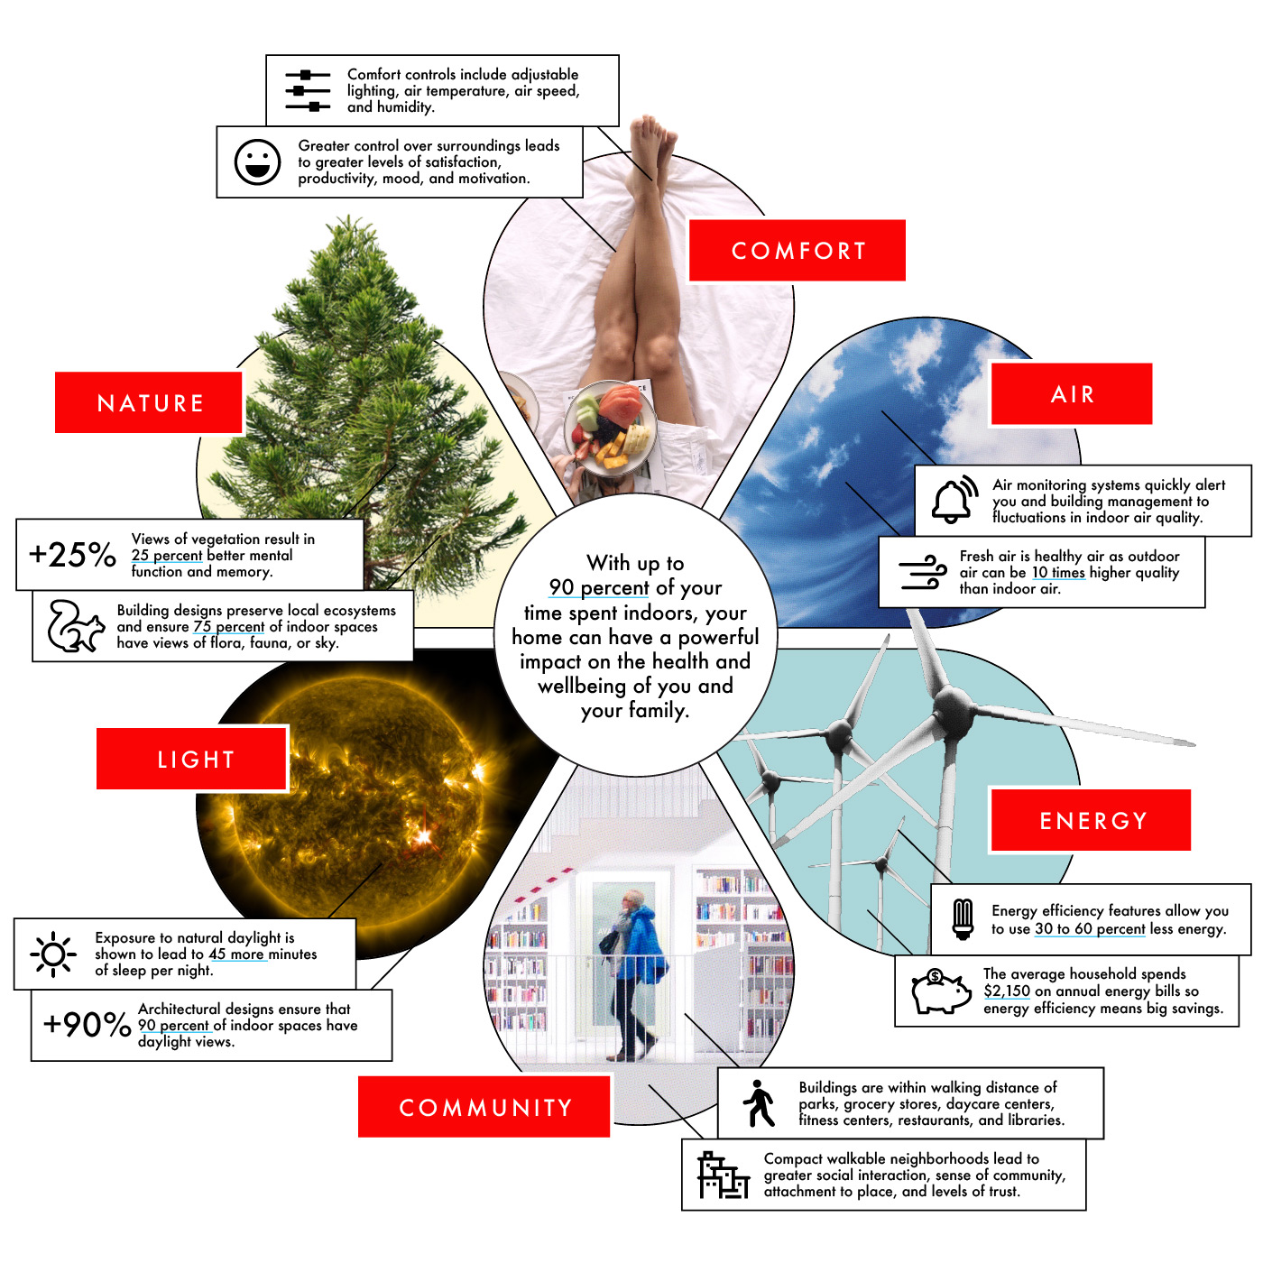
John Oppermann

Slide 10
john.oppermann@archpointadvisory.com 913.660.6485
John Oppermann

